Slide 1
MU-MIMO Communications With MIMO Radar: From Co-Existence to Joint Transmission
Fan Liu; Christos Masouros; Ang Li; Huafei Sun; Lajos Hanzo

Slide 2
Table of Contents
Abstract
Introduction
System Model
Problem Formulation

Slide 3
Abstract
Joint MIMO Radar-Communication System
  A single MIMO platform works as both
  Radar for target detection and communication BS for downlink users.
  The system performs simultaneous sensing and communication in the same frequency band.
  The paper considers two deployment modes:
    Separated Deployment
      Antennas are split into two groups:
      radar antennas and communication antennas
      Radar signal is forced into the null space of downlink channels
      The communication beamformer is designed to match the radar beampattern while satisfying user requirements
    Shared Deployment
      All antennas are shared by both radar and communication
      A joint waveform is transmitted for both functions
      Radar beampattern and downlink communication performance are designed jointly

Slide 4
Abstract
Beamforming Design and Key Results
  Original beamforming problems include:
    Radar beampattern design
    Downlink SINR constraints
    Transmit power constraints
  To simplify the design, the paper moves the SINR constraints into the objective function as penalty terms
  This converts the original constrained problems into weighted optimization problems
  The weighted problems are solved using manifold optimization algorithms
  Manifold methods provide:
    lower computational complexity
    efficient handling of equality constraints
    performance close to the original optimization

Slide 5
Introduction
Background and Motivation
  Joint MIMO Radar-Communication (RadCom)
    Wireless spectrum is becoming scarce, while both radar and communication systems need valuable frequency bands.
    A promising solution is a dual-functional platform that can perform:
      target sensing/detection
      downlink communication
      at the same time.
    This paper studies a joint MIMO RadCom system, where a single device acts as:
      a radar
      a communication base station (BS)
    Main objective: design beamforming so that the system can
      form a desired radar beampattern
      satisfy user SINR requirements
      stay within the power budget

Slide 6
Introduction
Background and Motivation
  Wireless spectrum is becoming scarce, while both radar and communication systems need valuable frequency bands.
  A promising solution is a dual-functional platform that can perform:
    target sensing/detection
    downlink communication
    at the same time.
  This paper studies a joint MIMO RadCom system, where a single device acts as:
    a radar
    a communication base station (BS)
  Main objective: design beamforming so that the system can
    form a desired radar beampattern
    satisfy user SINR requirements
    stay within the power budget

Slide 7
Introduction
Two Deployment Modes
  Separated vs Shared Deployment
  The paper considers two operational modes:
  1) Separated Deployment
    Antennas are split into:
      radar antennas
      communication antennas
    Radar signal is forced into the null-space of downlink channels
    Communication beamformer is designed to match the radar beampattern
    Drawback: extra zero-forcing constraints may reduce performance
  2) Shared Deployment
    All antennas are shared by radar and communication
    Communication signals also act as radar probing waveforms
    Joint design provides more flexibility and usually better performance

Slide 8
Introduction
Key Contribution and Main Result
  Bullet points:
  The paper proposes:
    separated deployment and shared deployment
    several weighted beamforming formulations
    manifold optimization methods for low-complexity solution
  Weighted problems are solved on Riemannian manifolds
  Manifold solvers achieve:
    near-optimal performance
    lower computational complexity
    better handling of equality constraints
  Main result:
    Shared deployment significantly outperforms separated deployment
    Weighted manifold-based methods perform similarly to original optimizations, but at much lower complexity

Slide 9
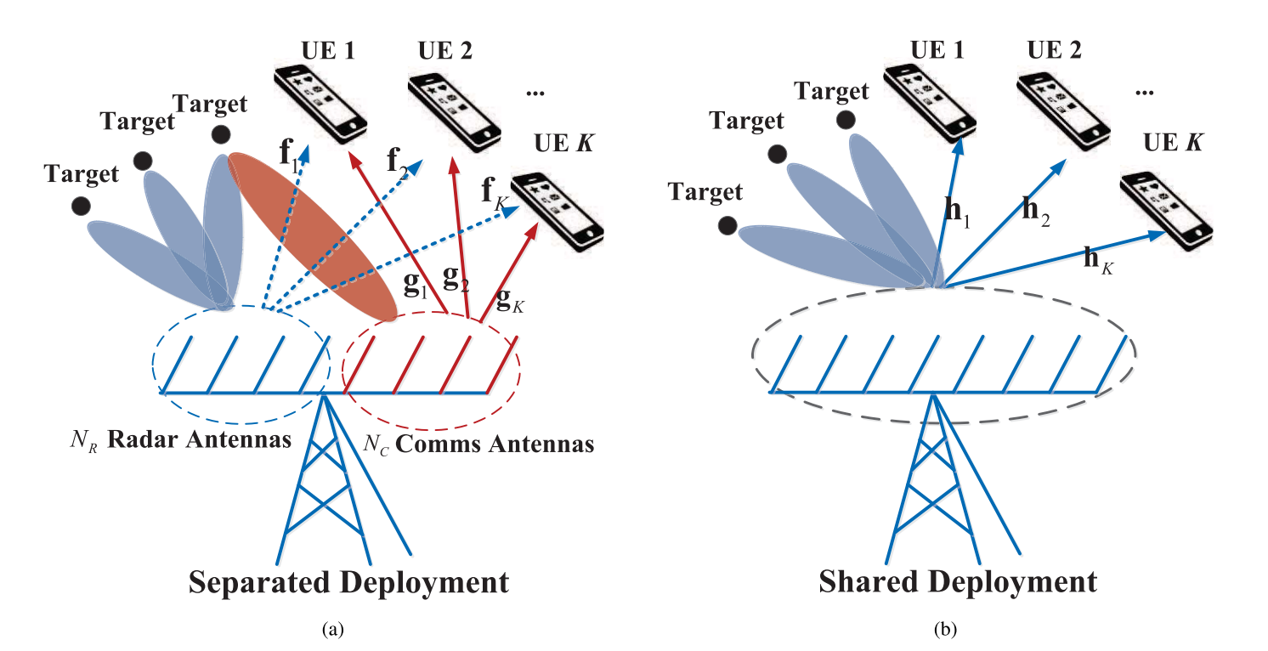
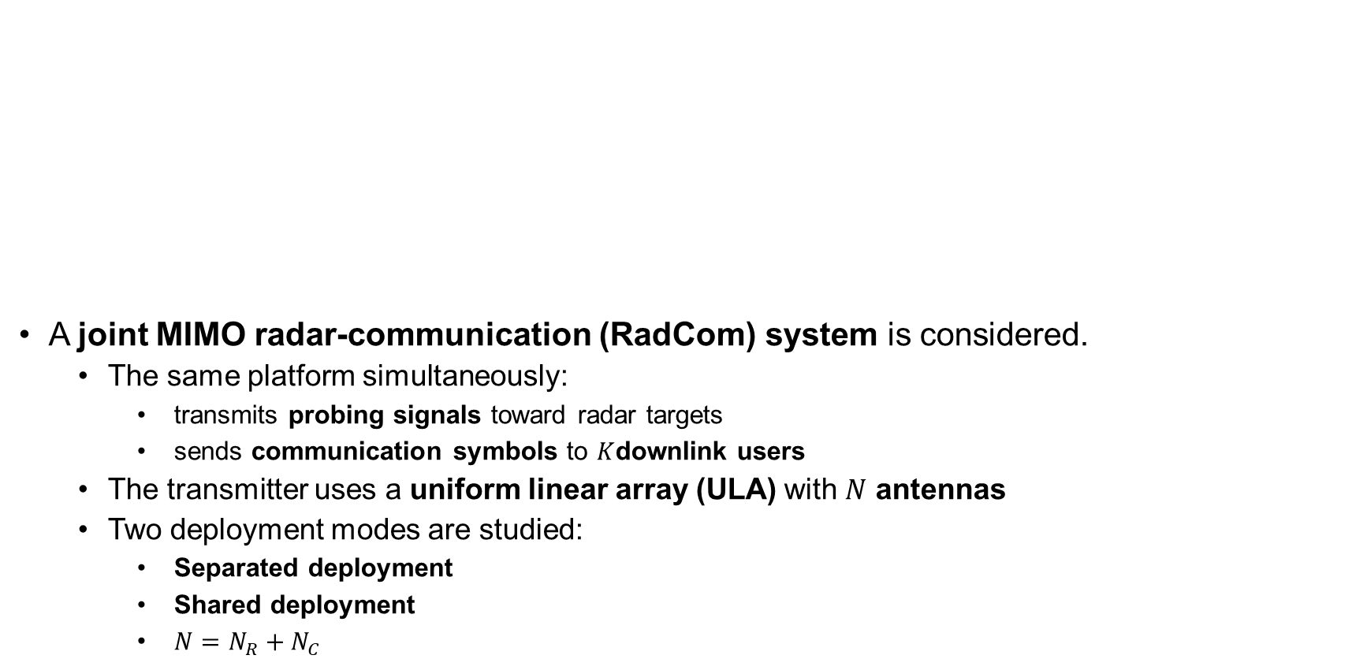
System Model
A joint MIMO radar-communication (RadCom) system is considered.
  The same platform simultaneously:
    transmits probing signals toward radar targets
    sends communication symbols to $K$downlink users
  The transmitter uses a uniform linear array (ULA) with $N$ antennas
  Two deployment modes are studied:
    Separated deployment
    Shared deployment
    $N=N_{R}+N_{C}$
Figure: Antenna deployments for the collocated radar and communications BS. (a) Separated deployment; (b) Shared deployment.

Slide 10
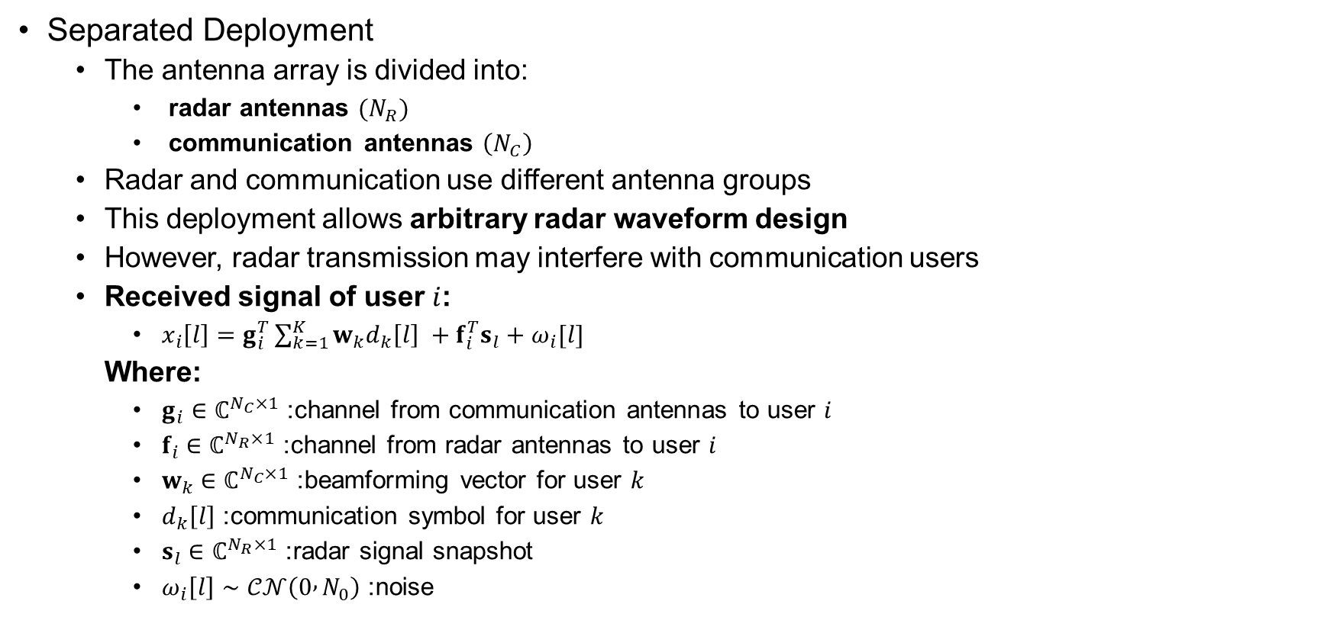
System Model
Separated Deployment
  The antenna array is divided into:
    radar antennas $(N_{R})$
    communication antennas $\left(N_{C}\right)$
  Radar and communication use different antenna groups
  This deployment allows arbitrary radar waveform design
  However, radar transmission may interfere with communication users
  Received signal of user $i$:
    $x_{i}\left[l\right]=g_{i}^{T}\sum_{k=1}^{K}{w_{k}d_{k}\left[l\right] +f_{i}^{T}s_{l}+ω_{i}[l]}$
  Where:
    $g_{i}∈ℂ^{N_{C}×1}$: channel from communication antennas to user $i$
    $f_{i}∈ℂ^{N_{R}×1}$: channel from radar antennas to user $i$
    $w_{k}∈ℂ^{N_{C}×1}$: beamforming vector for user $k$
    $d_{k}\left[l\right]$: communication symbol for user $k$
    $s_{l}∈ℂ^{N_{R}×1}$: radar signal snapshot
    $ω_{i}\left[l\right]∼𝒞𝒩\left(0 , N_{0}\right)$: noise

Slide 11
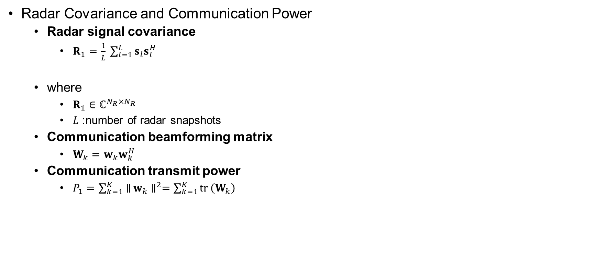
System Model
Radar Covariance and Communication Power
  Radar signal covariance
    $R_{1}=\frac{1}{L} \sum_{l=1}^{L}{s_{l}s_{l}^{H}}$
  where
    $R_{1}∈ℂ^{N_{R}×N_{R}}$
    $L$: number of radar snapshots
  Communication beamforming matrix
    $W_{k}=w_{k}w_{k}^{H}$
  Communication transmit power
    $P_{1}=\sum_{k=1}^{K}{∥}w_{k}∥^{2}=\sum_{k=1}^{K}{tr}⁡\left(W_{k}\right)$

Slide 12
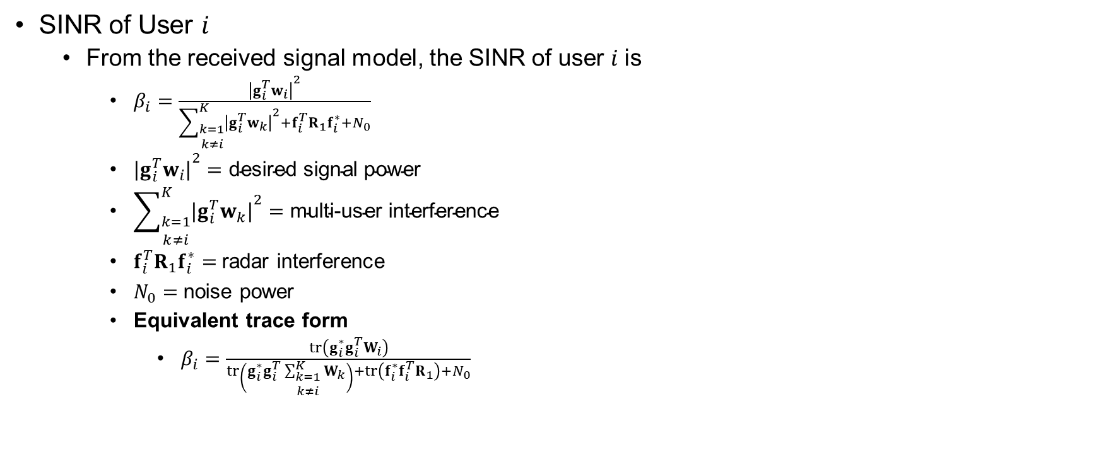
System Model
SINR of User $i$
  From the received signal model, the SINR of user $i$is
    $β_{i}=\frac{{∣g_{i}^{T}w_{i}∣}^{2}}{\sum_{\begin{matrix}k=1 \\ k≠i\end{matrix}}^{K}{{∣g_{i}^{T}w_{k}∣}^{2}}+f_{i}^{T}R_{1}f_{i}^{∗}+N_{0}}$
    ${∣g_{i}^{T}w_{i}∣}^{2}=\text{desired} \text{signal} \text{power}$
    $\sum_{\begin{matrix}k=1 \\ k≠i\end{matrix}}^{K}{{∣g_{i}^{T}w_{k}∣}^{2}}=\text{multi}\text{−}\text{user} \text{interference}$
    $f_{i}^{T}R_{1}f_{i}^{∗}=$radar interference
    $N_{0}=$noise power
    Equivalent trace form
      $β_{i}=\frac{\operatorname{tr}\left(g_{i}^{∗}g_{i}^{T}W_{i}\right)}{\operatorname{tr}\left(g_{i}^{∗}g_{i}^{T}\sum_{\begin{matrix}k=1 \\ k≠i\end{matrix}}^{K}{W_{k}}\right)+\operatorname{tr}\left(f_{i}^{∗}f_{i}^{T}R_{1}\right)+N_{0}}$

Slide 13
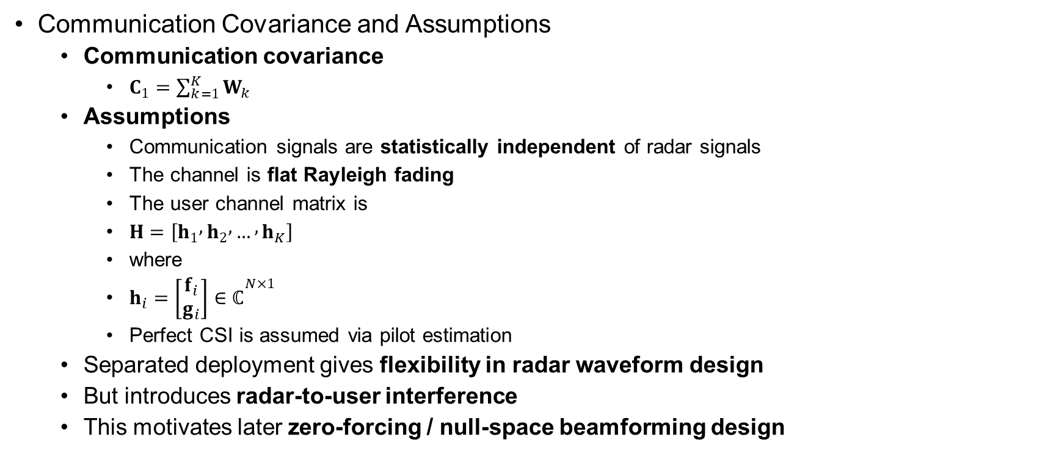
System Model
Communication Covariance and Assumptions
  Communication covariance
    $C_{1}=\sum_{k=1}^{K}{W_{k}}$
  Assumptions
    Communication signals are statistically independent of radar signals
    The channel is flat Rayleigh fading
    The user channel matrix is
    $H=\left[h_{1} , h_{2} , … , h_{K}\right]$
    where
    $h_{i}=\left[\begin{matrix}f_{i} \\ g_{i}\end{matrix}\right]∈ℂ^{N×1}$
    Perfect CSI is assumed via pilot estimation
  Separated deployment gives flexibility in radar waveform design
  But introduces radar-to-user interference
  This motivates later zero-forcing / null-space beamforming design

Slide 14
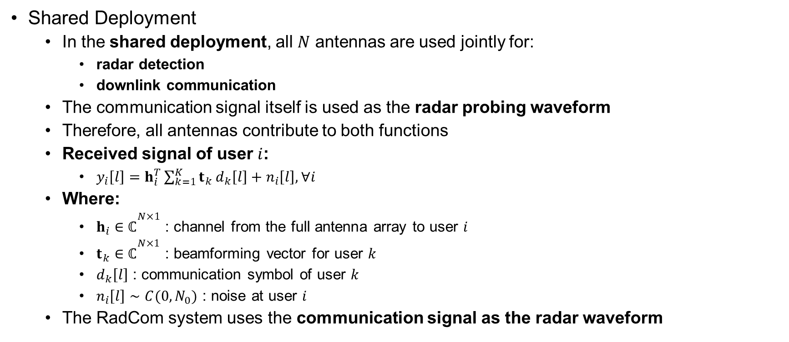
System Model
Shared Deployment
  In the shared deployment, all $N$ antennas are used jointly for:
    radar detection
    downlink communication
  The communication signal itself is used as the radar probing waveform
  Therefore, all antennas contribute to both functions
  Received signal of user $i$:
    $y_{i}\left[l\right]=h_{i}^{T}\sum_{k=1}^{K}{t_{k}}d_{k}\left[l\right]+n_{i}\left[l\right], ∀i$
  Where:
    $h_{i}∈ℂ^{N×1}$: channel from the full antenna array to user $i$
    $t_{k}∈ℂ^{N×1}$: beamforming vector for user $k$
    $d_{k}\left[l\right]$: communication symbol of user $k$
    $n_{i}\left[l\right]∼C(0, N_{0})$: noise at user $i$
  The RadCom system uses the communication signal as the radar waveform

Slide 15
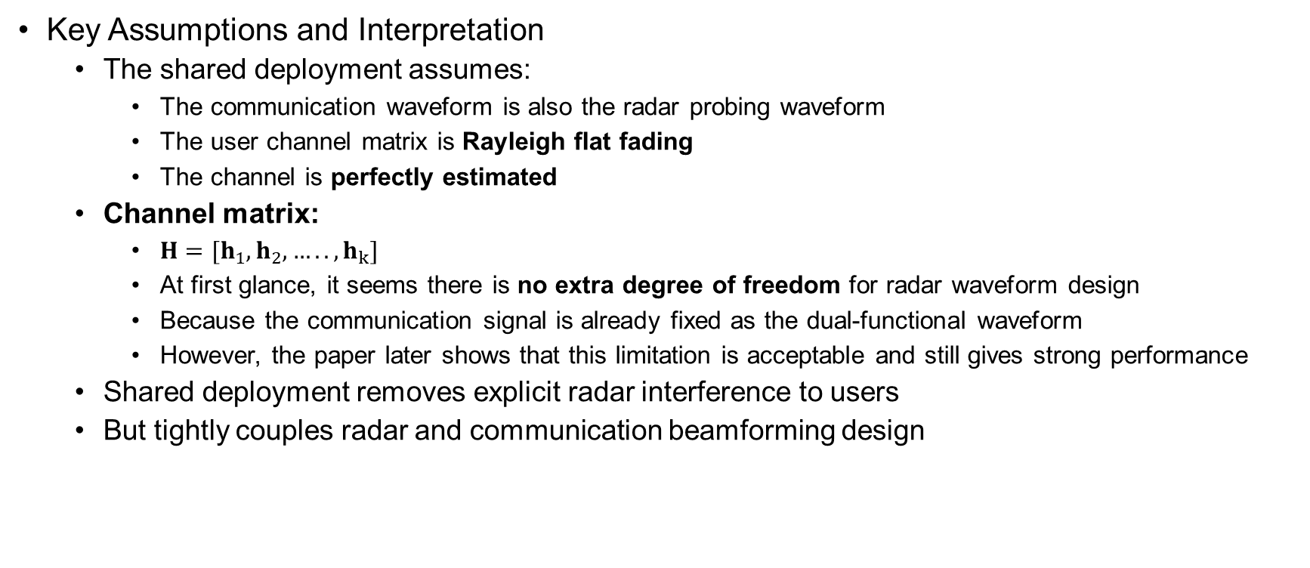
System Model
Key Assumptions and Interpretation
  The shared deployment assumes:
    The communication waveform is also the radar probing waveform
    The user channel matrix is Rayleigh flat fading
    The channel is perfectly estimated
  Channel matrix:
    $H=[h_{1},h_{2},….. , h_{k}]$
    At first glance, it seems there is no extra degree of freedom for radar waveform design
    Because the communication signal is already fixed as the dual-functional waveform
    However, the paper later shows that this limitation is acceptable and still gives strong performance
  Shared deployment removes explicit radar interference to users
  But tightly couples radar and communication beamforming design

Slide 16
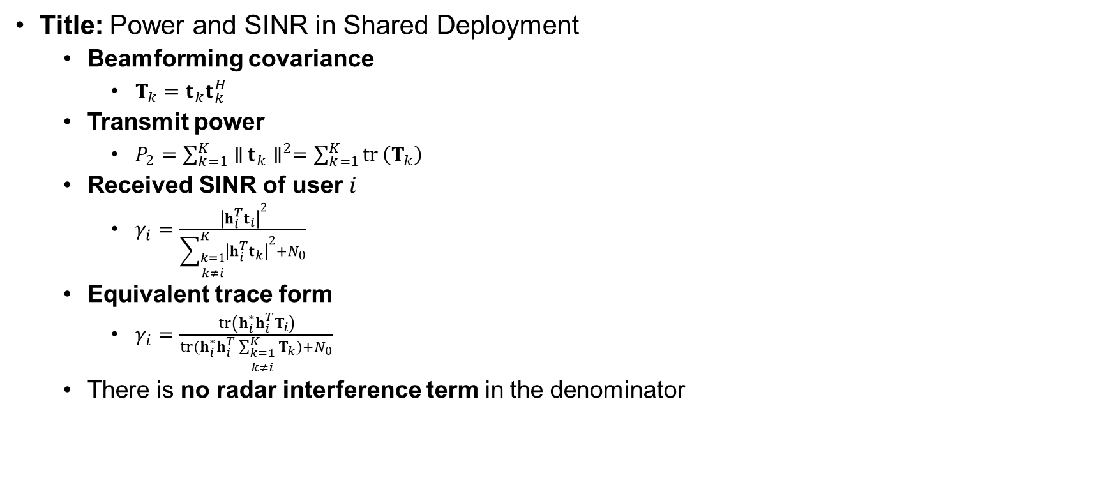
System Model
Title: Power and SINR in Shared Deployment
  Beamforming covariance
    $T_{k}=t_{k}t_{k}^{H}$
  Transmit power
    $P_{2}=\sum_{k=1}^{K}{∥}t_{k}∥^{2}=\sum_{k=1}^{K}{tr}⁡\left(T_{k}\right)$
  Received SINR of user $i$
    $γ_{i}=\frac{{∣h_{i}^{T}t_{i}∣}^{2}}{\sum_{\begin{matrix}k=1 \\ k≠i\end{matrix}}^{K}{{∣h_{i}^{T}t_{k}∣}^{2}}+N_{0}}$
  Equivalent trace form
    $γ_{i}=\frac{\operatorname{tr}\left(h_{i}^{∗}h_{i}^{T}T_{i}\right)}{tr(h_{i}^{∗}h_{i}^{T}\sum_{\begin{matrix}k=1 \\ k≠i\end{matrix}}^{K}{T_{k}})+N_{0}}$
  There is no radar interference term in the denominator

Slide 17
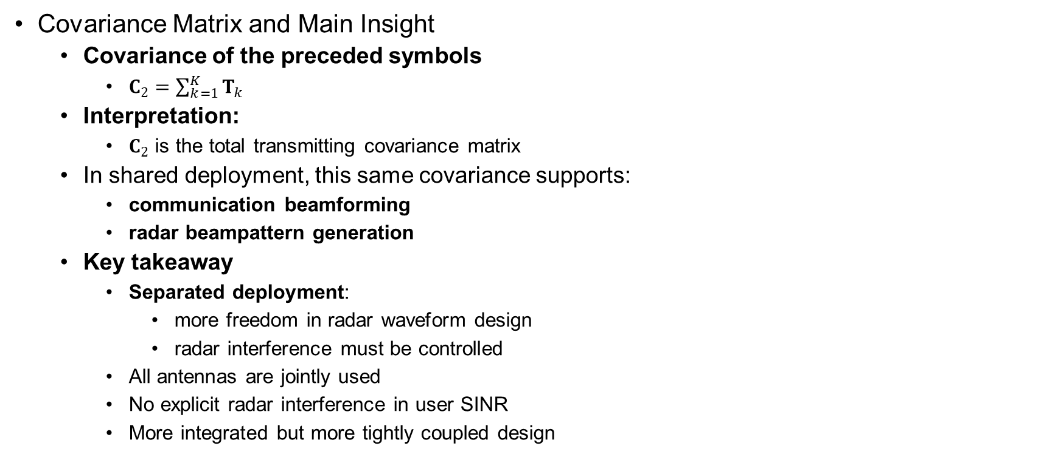
System Model
Covariance Matrix and Main Insight
  Covariance of the preceded symbols
    $C_{2}=\sum_{k=1}^{K}{T_{k}}$
  Interpretation:
    $C_{2}$ is the total transmitting covariance matrix
  In shared deployment, this same covariance supports:
    communication beamforming
    radar beampattern generation
  Key takeaway
    Separated deployment:
      more freedom in radar waveform design
      radar interference must be controlled
    All antennas are jointly used
    No explicit radar interference in user SINR
    More integrated but more tightly coupled design

Slide 18
Problem Formulation
Problem Formulation
  Problem Formulation
  The beamformer must satisfy three requirements:
    Radar requirement: generate a beampattern close to the desired one
    Communication requirement: satisfy the required user SINR levels
    Power requirement: remain within the transmit power budget
  Key statement:
    The paper first recalls radar-only beampattern design
    Then it combines radar design with communication constraints
    The goal is to obtain a beamformer that supports both sensing and communication
  Important note:
    Low PAPR is important in practical radar waveform design
    But this paper does not optimize PAPR
    Reason: the approach is beamforming-level, not symbol-level/waveform-level

Slide 19
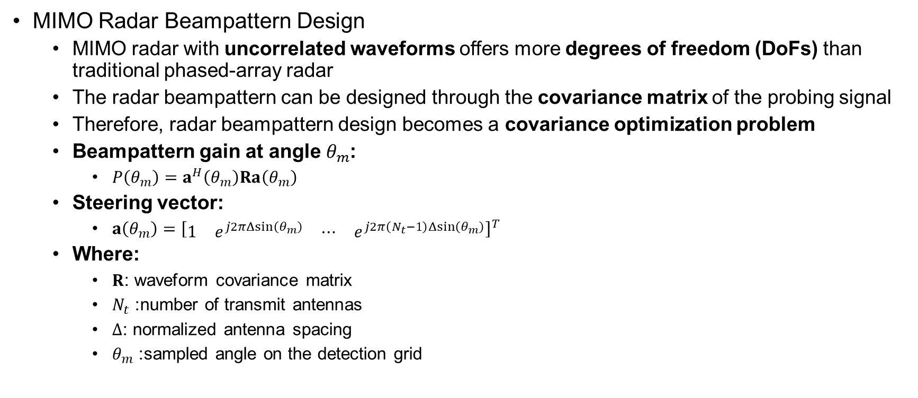
Problem Formulation
MIMO Radar Beampattern Design
  MIMO radar with uncorrelated waveforms offers more degrees of freedom (DoFs) than traditional phased-array radar
  The radar beampattern can be designed through the covariance matrix of the probing signal
  Therefore, radar beampattern design becomes a covariance optimization problem
  Beampattern gain at angle $θ_{m}$:
    $P\left(θ_{m}\right)=a^{H}\left(θ_{m}\right)Ra\left(θ_{m}\right)$
  Steering vector:
    $a\left(θ_{m}\right)={\left[\begin{matrix}1 & e^{j2πΔsin⁡\left(θ_{m}\right)} & ⋯ & e^{j2π\left(N_{t}−1\right)Δsin⁡\left(θ_{m}\right)}\end{matrix}\right]}^{T}$
  Where:
    $R$: waveform covariance matrix
    $N_{t}$: number of transmit antennas
    $Δ$: normalized antenna spacing
    $θ_{m}$: sampled angle on the detection grid

Slide 20
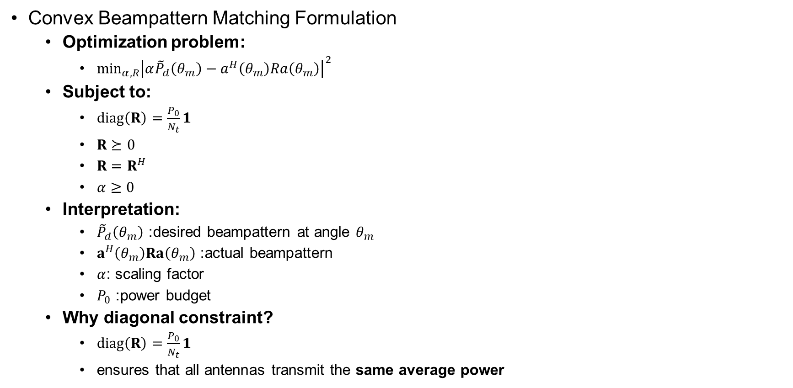
Problem Formulation
Convex Beampattern Matching Formulation
  Optimization problem:
    $\min_{α,R}{{\left|α{\tilde{P}}_{d}\left(θ_{m}\right)−a^{H}\left(θ_{m}\right)Ra\left(θ_{m}\right)\right|}^{2}}$
  Subject to:
    $diag⁡\left(R\right)=\frac{P_{0}}{N_{t}}1$
    $R⪰0$
    $R=R^{H}$
    $α≥0$
  Interpretation:
    ${\tilde{P}}_{d}\left(θ_{m}\right)$: desired beampattern at angle $θ_{m}$
    $a^{H}\left(θ_{m}\right)Ra\left(θ_{m}\right)$: actual beampattern
    $α$: scaling factor
    $P_{0}$: power budget
  Why diagonal constraint?
    $diag⁡\left(R\right)=\frac{P_{0}}{N_{t}}1$
    ensures that all antennas transmit the same average power

Slide 21
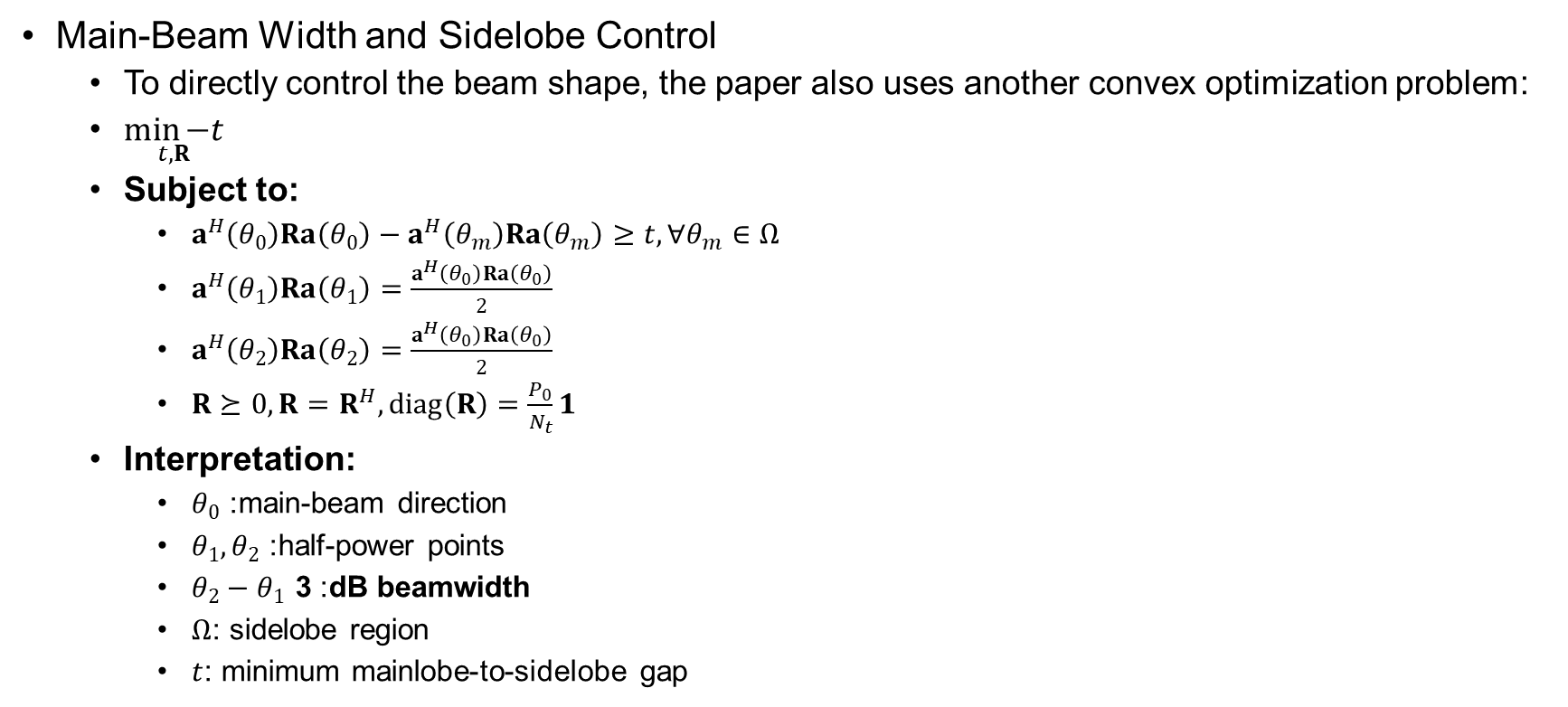
Problem Formulation
Main-Beam Width and Sidelobe Control
  To directly control the beam shape, the paper also uses another convex optimization problem:
  $\underset{t,R}{\min{−t}}$
  Subject to:
    $a^{H}\left(θ_{0}\right)Ra\left(θ_{0}\right)−a^{H}\left(θ_{m}\right)Ra\left(θ_{m}\right)≥t, ∀θ_{m}∈Ω$
    $a^{H}\left(θ_{1}\right)Ra\left(θ_{1}\right)=\frac{a^{H}\left(θ_{0}\right)Ra\left(θ_{0}\right)}{2}$
    $a^{H}\left(θ_{2}\right)Ra\left(θ_{2}\right)=\frac{a^{H}\left(θ_{0}\right)Ra\left(θ_{0}\right)}{2}$
    $R⪰0, R=R^{H}, diag⁡\left(R\right)=\frac{P_{0}}{N_{t}}1$
  Interpretation:
    $θ_{0}$: main-beam direction
    $θ_{1},θ_{2}$: half-power points
    $θ_{2}−θ_{1}$: 3 dB beamwidth
    $Ω$: sidelobe region
    $t$: minimum mainlobe-to-sidelobe gap

Slide 22
Problem Formulation
Key Message of Radar-Only Formulation
  Radar beampattern design is reformulated as covariance matrix optimization
  Two convex radar-only formulations are used:
    Least-squares beampattern matching
    3 dB beamwidth and sidelobe control
  These radar formulations will later be combined with:
    SINR constraints
    power constraints
    joint radar-communication beamforming
  Section III-A provides the radar design foundation
  Later sections integrate it with communication requirements

Slide 23
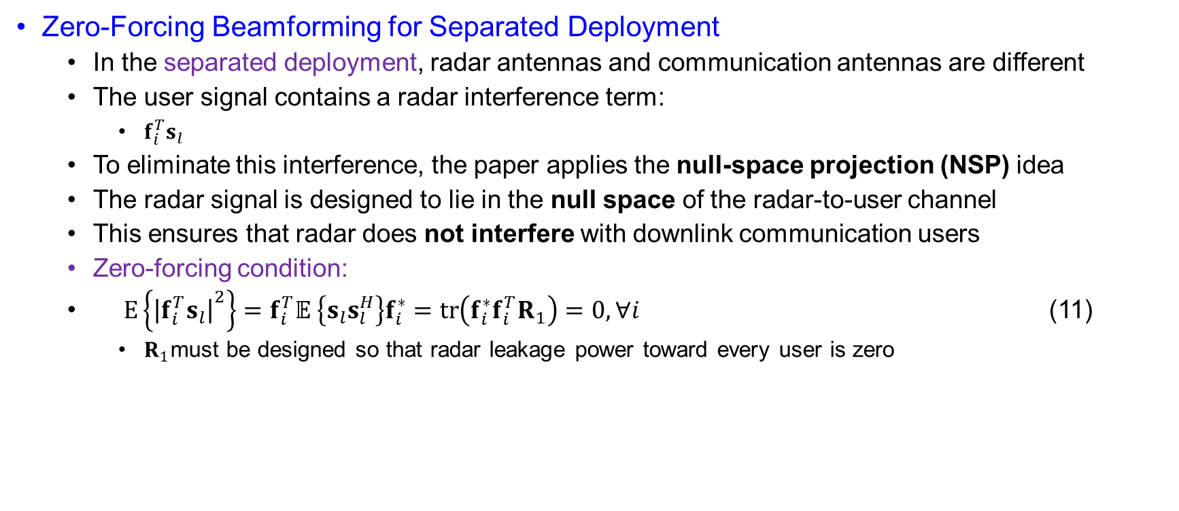
Problem Formulation
Zero-Forcing Beamforming for Separated Deployment
  In the separated deployment, radar antennas and communication antennas are different
  The user signal contains a radar interference term:
    $f_{i}^{T}s_{l}$
  To eliminate this interference, the paper applies the null-space projection (NSP) idea
  The radar signal is designed to lie in the null space of the radar-to-user channel
  This ensures that radar does not interfere with downlink communication users
  Zero-forcing condition:
  $\begin{matrix} & E\left\{{∣f_{i}^{T}s_{l}∣}^{2}\right\}=f_{i}^{T}𝔼 \left\{s_{l}s_{l}^{H}\right\}f_{i}^{∗}=\operatorname{tr}\left(f_{i}^{∗}f_{i}^{T}R_{1}\right)=0, ∀i & & \end{matrix}$ (11)
    $R_{1}$must be designed so that radar leakage power toward every user is zero

Slide 24
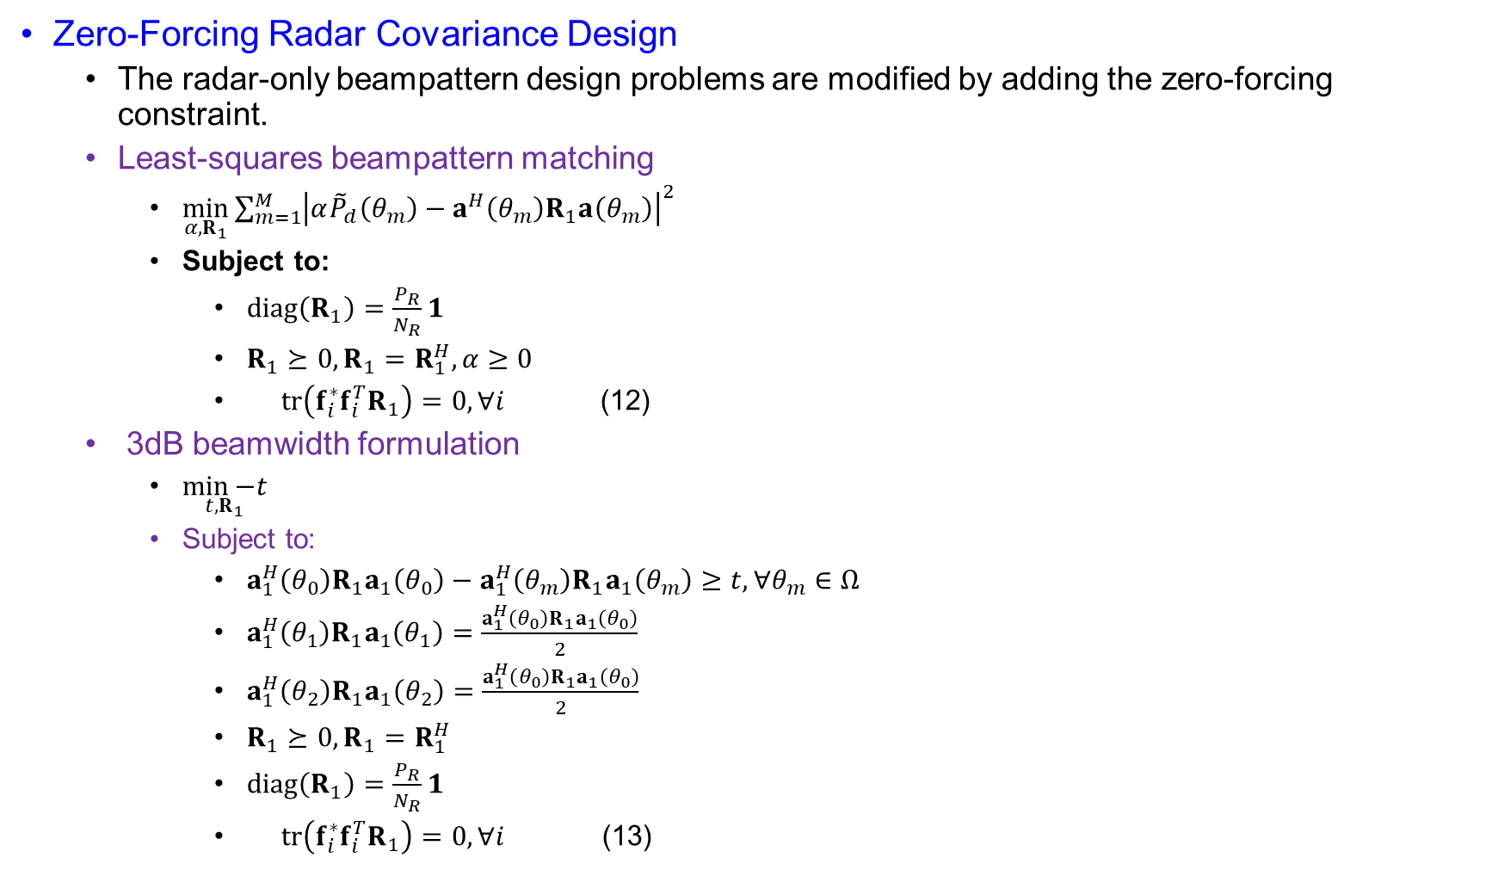
Problem Formulation
Zero-Forcing Radar Covariance Design
  The radar-only beampattern design problems are modified by adding the zero-forcing constraint.
  Least-squares beampattern matching
    $\min_{α,R_{1}}{\sum_{m=1}^{M}{{\left|α{\tilde{P}}_{d}\left(θ_{m}\right)−a^{H}\left(θ_{m}\right)R_{1}a\left(θ_{m}\right)\right|}^{2}}}$
    Subject to:
      $diag⁡\left(R_{1}\right)=\frac{P_{R}}{N_{R}}1$
      $R_{1}⪰0, R_{1}=R_{1}^{H}, α≥0$
      $\begin{matrix} & tr\left(f_{i}^{∗}f_{i}^{T}R_{1}\right)=0, ∀i & & \end{matrix}$ (12)
  3 dB beamwidth formulation
    $\underset{t,R_{1}}{\min{−t}}$
    Subject to:
      $a_{1}^{H}\left(θ_{0}\right)R_{1}a_{1}\left(θ_{0}\right)−a_{1}^{H}\left(θ_{m}\right)R_{1}a_{1}\left(θ_{m}\right)≥t, ∀θ_{m}∈Ω$
      $a_{1}^{H}\left(θ_{1}\right)R_{1}a_{1}\left(θ_{1}\right)=\frac{a_{1}^{H}\left(θ_{0}\right)R_{1}a_{1}\left(θ_{0}\right)}{2}$
      $a_{1}^{H}\left(θ_{2}\right)R_{1}a_{1}\left(θ_{2}\right)=\frac{a_{1}^{H}\left(θ_{0}\right)R_{1}a_{1}\left(θ_{0}\right)}{2}$
      $R_{1}⪰0, R_{1}=R_{1}^{H}$
      $diag⁡\left(R_{1}\right)=\frac{P_{R}}{N_{R}}1$
      $\begin{matrix} & tr\left(f_{i}^{∗}f_{i}^{T}R_{1}\right)=0, ∀i & & \end{matrix}$ (13)

Slide 25
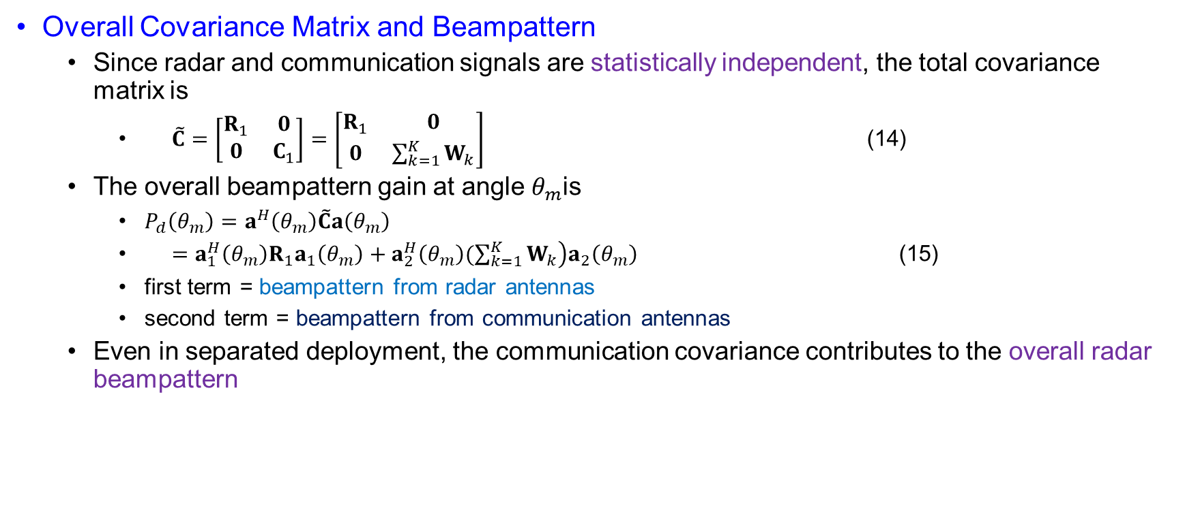
Problem Formulation
Overall Covariance Matrix and Beampattern
  Since radar and communication signals are statistically independent, the total covariance matrix is
    $\begin{matrix} & \tilde{C}=\left[\begin{matrix}R_{1} & 0 \\ 0 & C_{1}\end{matrix}\right]=\left[\begin{matrix}R_{1} & 0 \\ 0 & \sum_{k=1}^{K}{W_{k}}\end{matrix}\right] & & \end{matrix}$ (14)
  The overall beampattern gain at angle $θ_{m}$is
    $P_{d}\left(θ_{m}\right)=a^{H}\left(θ_{m}\right)\tilde{C}a\left(θ_{m}\right)$
    $\begin{matrix} & =a_{1}^{H}\left(θ_{m}\right)R_{1}a_{1}\left(θ_{m}\right)+a_{2}^{H}\left(θ_{m}\right)\left.(\sum_{k=1}^{K}{W_{k}}\right)a_{2}\left(θ_{m}\right) & & \end{matrix}$ (15)
    first term = beampattern from radar antennas
    second term = beampattern from communication antennas
  Even in separated deployment, the communication covariance contributes to the overall radar beampattern

Slide 26
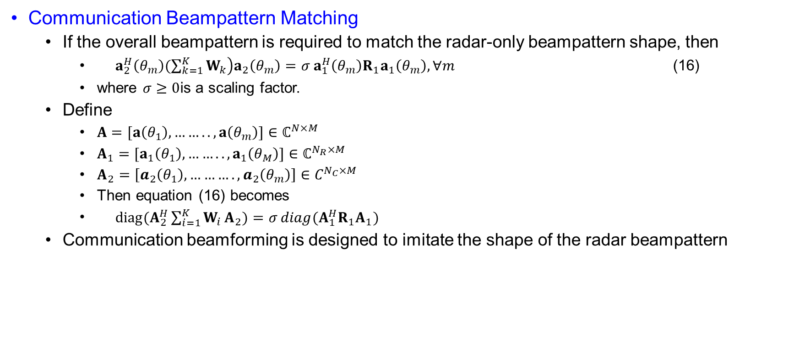
Problem Formulation
Communication Beampattern Matching
  If the overall beampattern is required to match the radar-only beampattern shape, then
    $\begin{matrix} & a_{2}^{H}\left(θ_{m}\right)\left.(\sum_{k=1}^{K}{W_{k}}\right)a_{2}\left(θ_{m}\right)=σ a_{1}^{H}\left(θ_{m}\right)R_{1}a_{1}\left(θ_{m}\right), ∀m & & \end{matrix}$ (16)
    where $σ≥0$is a scaling factor.
  Define
    $A=[a\left(θ_{1}\right),……..,a\left(θ_{m}\right)]∈ℂ^{N×M}$
    $A_{1}=[a_{1}\left(θ_{1}\right),……..,a_{1}\left(θ_{M}\right)]∈ℂ^{N_{R}×M}$
    $A_{2}=\left[a_{2}\left(θ_{1}\right),……….,a_{2}\left(θ_{m}\right)\right]∈C^{N_{C}×M}$
    Then equation (16) becomes
    $\begin{matrix} & diag(A_{2}^{H}\sum_{i=1}^{K}{W_{i}}A_{2})=σ diag(A_{1}^{H}R_{1}A_{1}) & & \end{matrix}$
  Communication beamforming is designed to imitate the shape of the radar beampattern

Slide 27
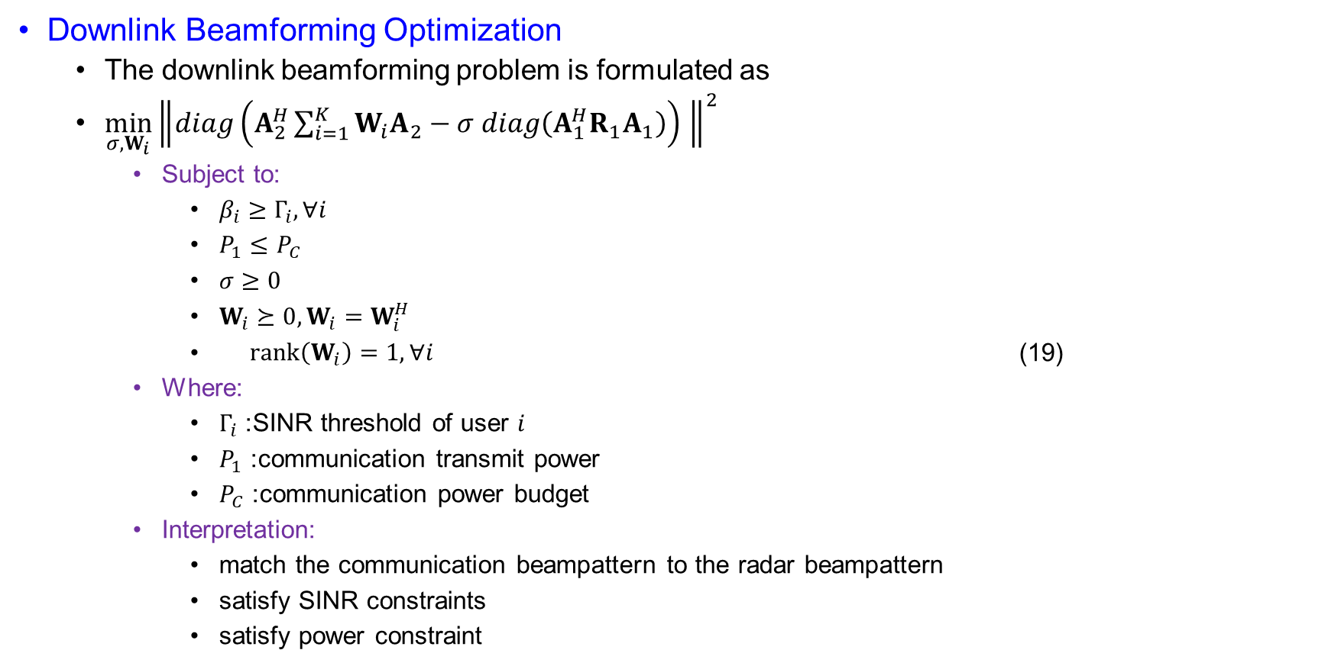
Problem Formulation
Downlink Beamforming Optimization
  The downlink beamforming problem is formulated as
  $\min_{σ,W_{i}}{{\left\|diag\left(A_{2}^{H}\sum_{i=1}^{K}{W_{i}A_{2}}−σ diag\left(A_{1}^{H}R_{1}A_{1}\right)\right) \right\|}^{2}}$
    Subject to:
      $β_{i}≥Γ_{i}, ∀i$
      $P_{1}≤P_{C}$
      $σ≥0$
      $W_{i}⪰0, W_{i}=W_{i}^{H}$
      $\begin{matrix} & rank⁡\left(W_{i}\right)=1, ∀i & & \end{matrix}$ (19)
    Where:
      $Γ_{i}$: SINR threshold of user $i$
      $P_{1}$: communication transmit power
      $P_{C}$: communication power budget
    Interpretation:
      match the communication beampattern to the radar beampattern
      satisfy SINR constraints
      satisfy power constraint

Slide 28
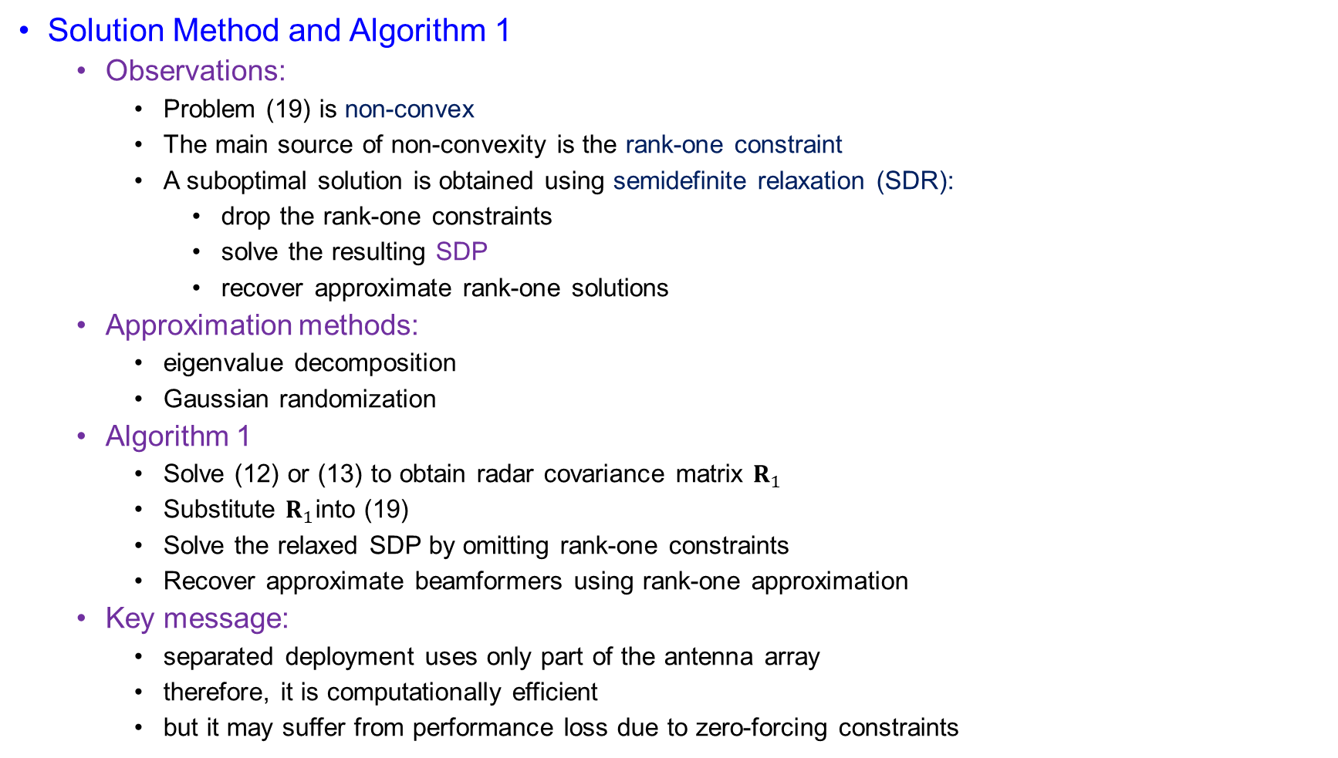
Problem Formulation
Solution Method and Algorithm 1
  Observations:
    Problem (19) is non-convex
    The main source of non-convexity is the rank-one constraint
    A suboptimal solution is obtained using semidefinite relaxation (SDR):
      drop the rank-one constraints
      solve the resulting SDP
      recover approximate rank-one solutions
  Approximation methods:
    eigenvalue decomposition
    Gaussian randomization
  Algorithm 1
    Solve (12) or (13) to obtain radar covariance matrix $R_{1}$
    Substitute $R_{1}$into (19)
    Solve the relaxed SDP by omitting rank-one constraints
    Recover approximate beamformers using rank-one approximation
  Key message:
    separated deployment uses only part of the antenna array
    therefore, it is computationally efficient
    but it may suffer from performance loss due to zero-forcing constraints

Slide 29
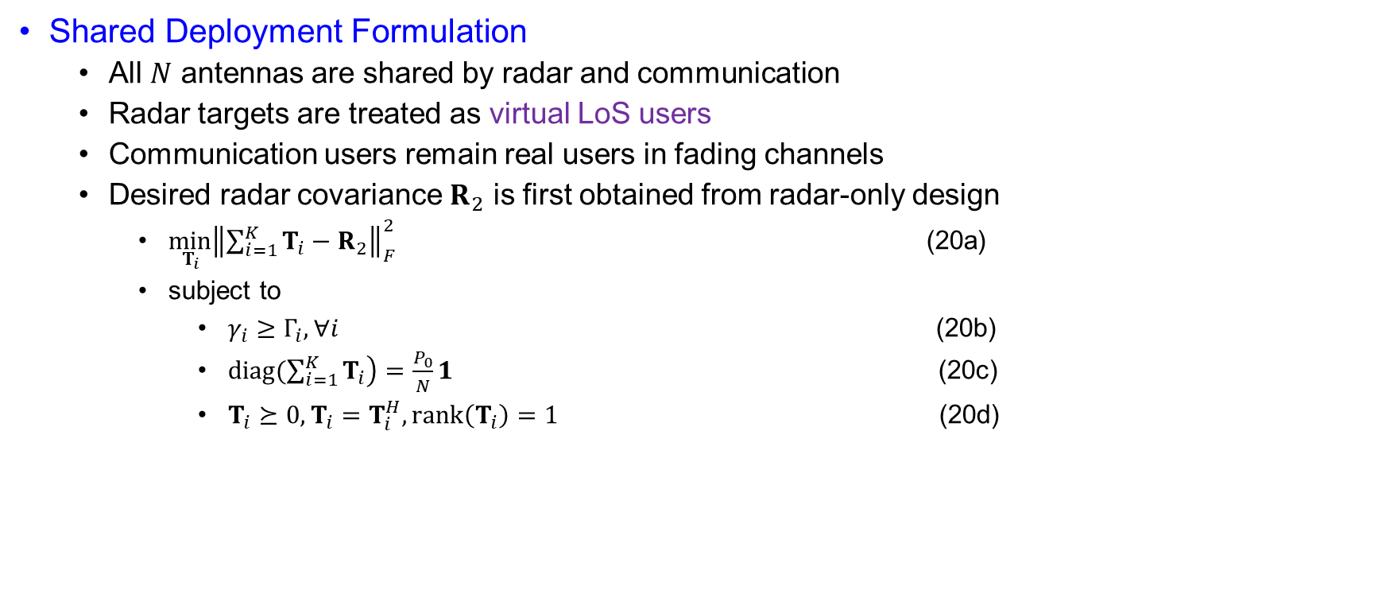
Problem Formulation
Shared Deployment Formulation
  All $N$ antennas are shared by radar and communication
  Radar targets are treated as virtual LoS users
  Communication users remain real users in fading channels
  Desired radar covariance $R_{2}$ is first obtained from radar-only design
    $\min_{T_{i}}{{\left\|\sum_{i=1}^{K}{T_{i}−R_{2}}\right\|}_{F}^{2}}$ (20a)
    subject to
      $γ_{i}≥Γ_{i}, ∀i$ (20b)
      $\operatorname{diag}\left.(\sum_{i=1}^{K}{T_{i}}\right)=\frac{P_{0}}{N}1$ (20c)
      $T_{i}⪰0, T_{i}=T_{i}^{H}, rank⁡\left(T_{i}\right)=1$ (20d)

Slide 30
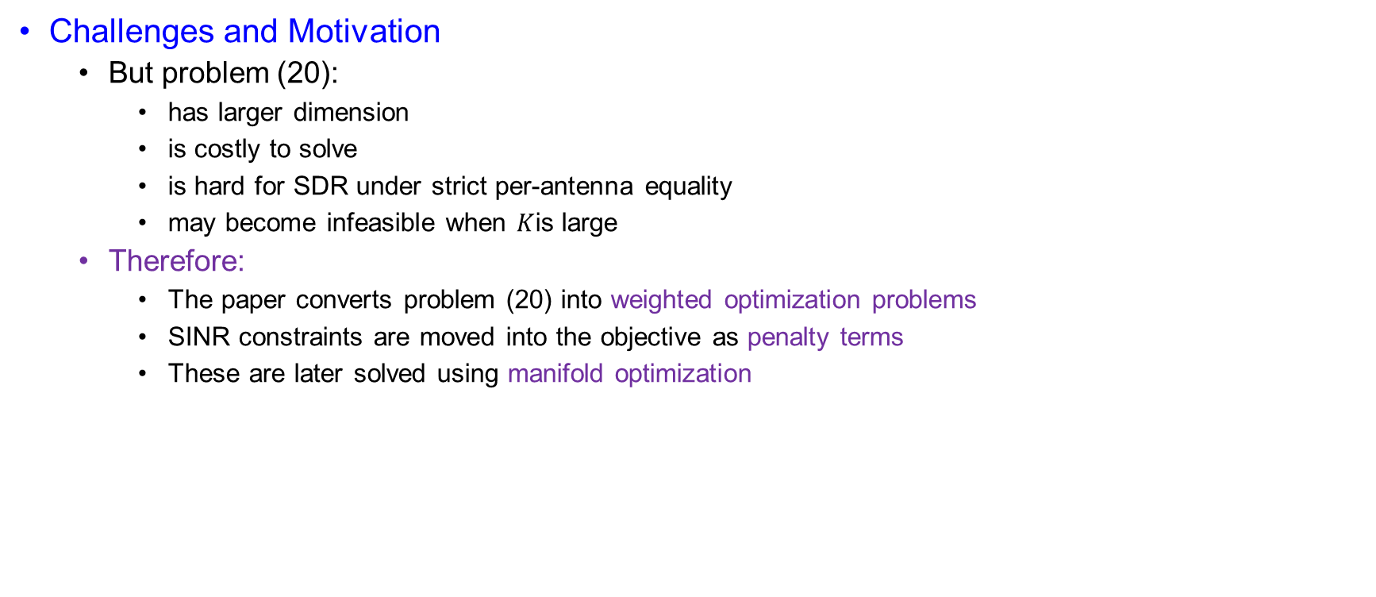
Problem Formulation
Challenges and Motivation
  But problem (20):
    has larger dimension
    is costly to solve
    is hard for SDR under strict per-antenna equality
    may become infeasible when $K$is large
  Therefore:
    The paper converts problem (20) into weighted optimization problems
    SINR constraints are moved into the objective as penalty terms
    These are later solved using manifold optimization

Slide 31
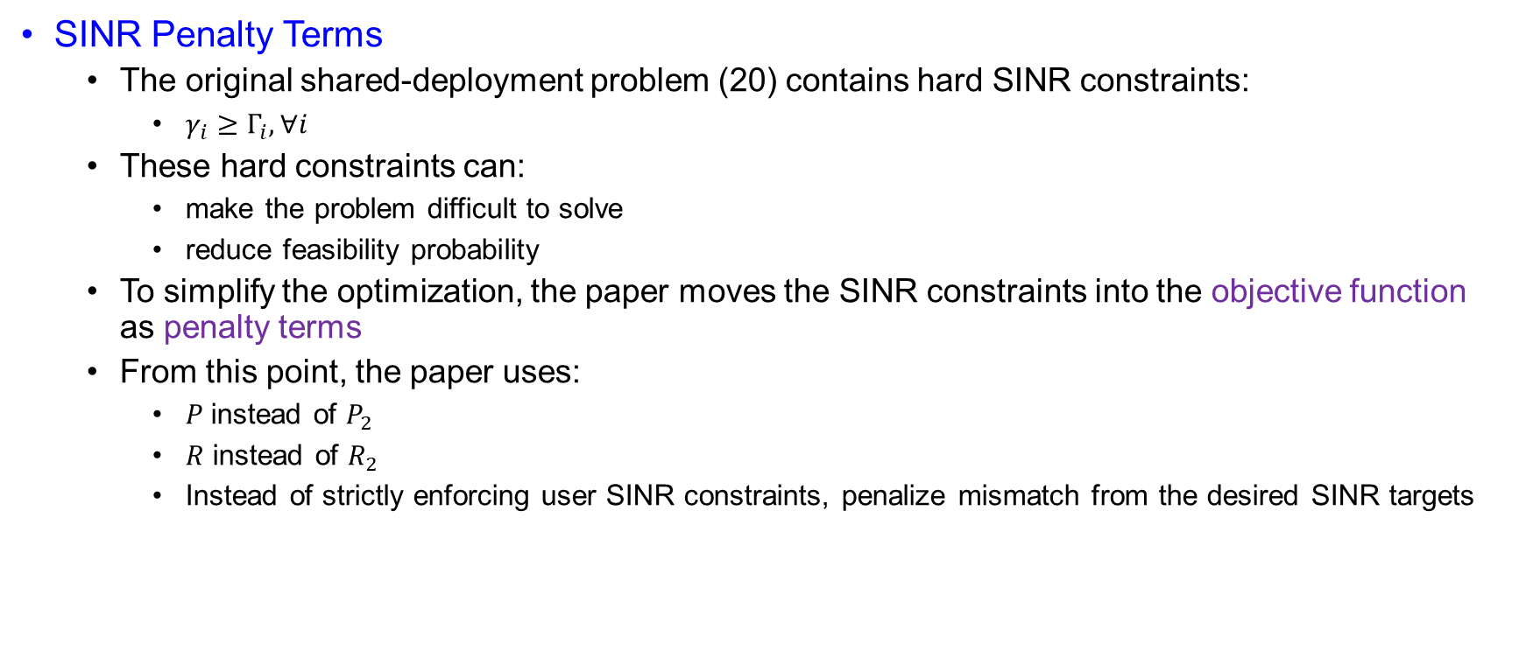
Problem Formulation
SINR Penalty Terms
  The original shared-deployment problem (20) contains hard SINR constraints:
    $γ_{i}≥Γ_{i}, ∀i$
  These hard constraints can:
    make the problem difficult to solve
    reduce feasibility probability
  To simplify the optimization, the paper moves the SINR constraints into the objective function as penalty terms
  From this point, the paper uses:
    $P$instead of $P_{2}$
    $R$ instead of $R_{2}$
    Instead of strictly enforcing user SINR constraints, penalize mismatch from the desired SINR targets

Slide 32
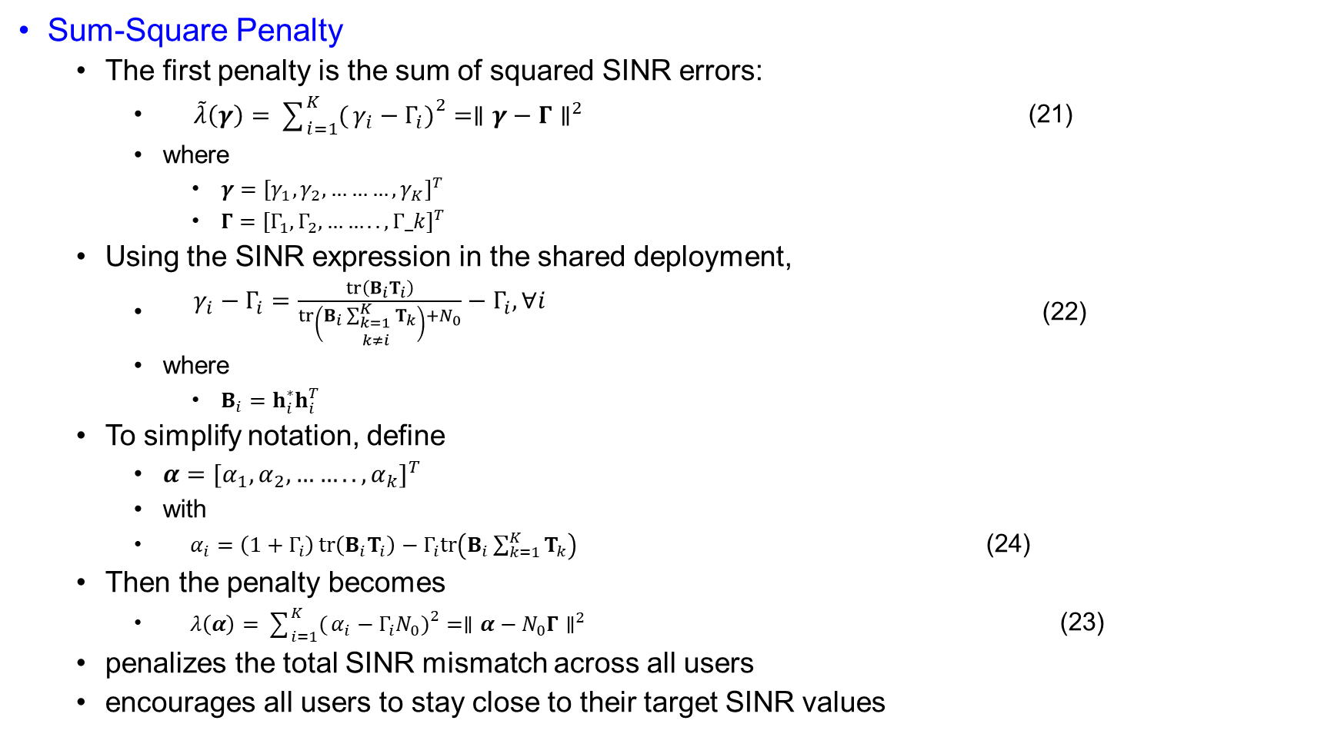
Problem Formulation
Sum-Square Penalty
  The first penalty is the sum of squared SINR errors:
    $\begin{matrix} & \tilde{λ}\left(γ\right)=\sum_{i=1}^{K}{(}\left.γ_{i}−Γ_{i}{\left.)\right.}^{2}=∥γ−Γ∥^{2}\right. & & \end{matrix}$ (21)
    where
      $γ={[γ_{1},γ_{2},………,γ_{K}]}^{T}$
      $Γ={[Γ_{1},Γ_{2},……..,Γ_k]}^{T}$
  Using the SINR expression in the shared deployment,
    $\begin{matrix} & γ_{i}−Γ_{i}=\frac{tr⁡\left(B_{i}T_{i}\right)}{tr\left(B_{i}\sum_{\begin{matrix}k=1 \\ k≠i\end{matrix}}^{K}{T_{k}}\right)+N_{0}}−Γ_{i}, ∀i & & \end{matrix}$ (22)
    where
      $B_{i}=h_{i}^{∗}h_{i}^{T}$
  To simplify notation, define
    $α={[α_{1},α_{2},……..,α_{k}]}^{T}$
    with
    $\begin{matrix} & α_{i}=\left(1+Γ_{i}\right)\operatorname{tr}\left(B_{i}T_{i}\right)−Γ_{i}tr\left(B_{i}\sum_{k=1}^{K}{T_{k}}\right) & & \end{matrix}$ (24)
  Then the penalty becomes
    $\begin{matrix} & λ\left(α\right)=\sum_{i=1}^{K}{(}\left.α_{i}−Γ_{i}N_{0}{\left.)\right.}^{2}=∥α−N_{0}Γ∥^{2}\right. & & \end{matrix}$ (23)
  penalizes the total SINR mismatch across all users
  encourages all users to stay close to their target SINR values

Slide 33
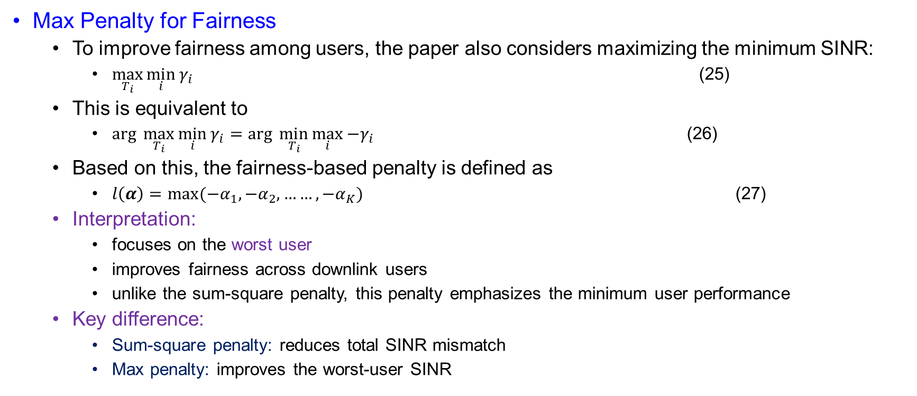
Problem Formulation
Max Penalty for Fairness
  To improve fairness among users, the paper also considers maximizing the minimum SINR:
    $\max_{T_{i}}{\min_{i}{γ_{i}}}$ (25)
  This is equivalent to
    $arg \max_{T_{i}}{\min_{i}{γ_{i}}}=arg \min_{T_{i}}{\max_{i}{−γ_{i}}}$ (26)
  Based on this, the fairness-based penalty is defined as
    $l\left(α\right)=max⁡(−α_{1},−α_{2},……,−α_{K})$ (27)
  Interpretation:
    focuses on the worst user
    improves fairness across downlink users
    unlike the sum-square penalty, this penalty emphasizes the minimum user performance
  Key difference:
    Sum-square penalty: reduces total SINR mismatch
    Max penalty: improves the worst-user SINR

Slide 34
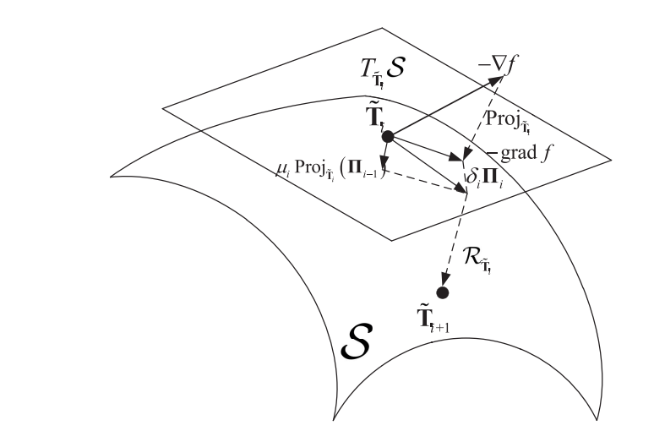
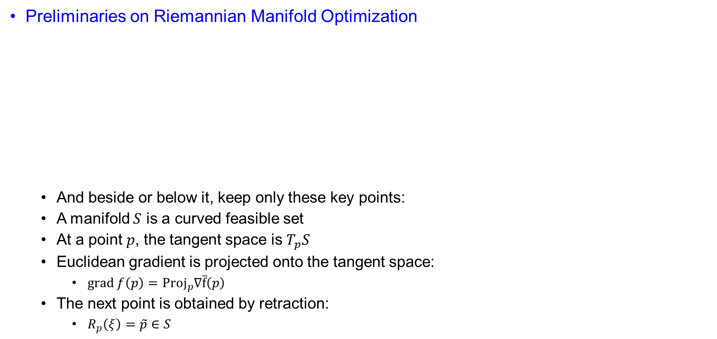
Beamforming Optimization on The Manifold
Preliminaries on Riemannian Manifold Optimization
  And beside or below it, keep only these key points:
  A manifold $S$ is a curved feasible set
  At a point $p$, the tangent space is $T_{p}S$
  Euclidean gradient is projected onto the tangent space:
    $grad f\left(p\right)={Proj}_{p}∇\overline{f}\left(p\right)$
  The next point is obtained by retraction:
    $R_{p}\left(ξ\right)=\tilde{p}∈S$
Fig. 2. Riemannian conjugate gradient algorithm

Slide 35
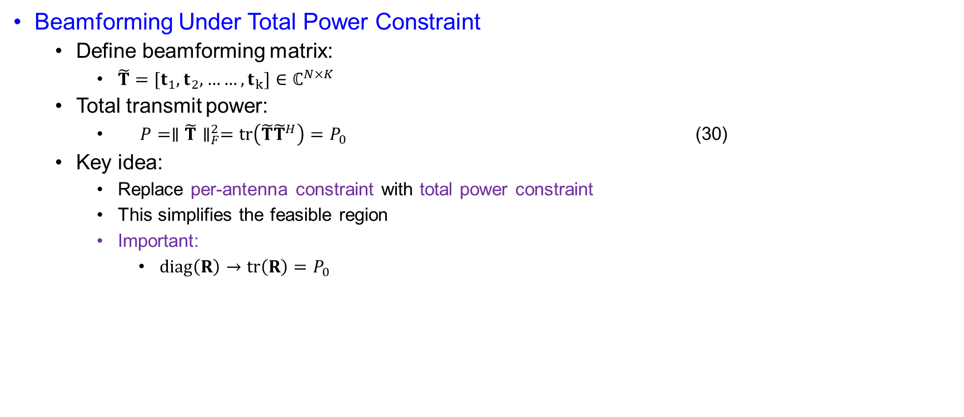
Beamforming Optimization on The Manifold
Beamforming Under Total Power Constraint
  Define beamforming matrix:
    $\tilde{T}=[t_{1},t_{2},……,t_{k}]∈ℂ^{N×K}$
  Total transmit power:
    $\begin{matrix} & P=∥\tilde{T}∥_{F}^{2}=tr⁡\left(\tilde{T}{\tilde{T}}^{H}\right)=P_{0} & & \end{matrix}$ (30)
  Key idea:
    Replace per-antenna constraint with total power constraint
    This simplifies the feasible region
    Important:
      $diag⁡\left(R\right)→tr⁡\left(R\right)=P_{0}$

Slide 36
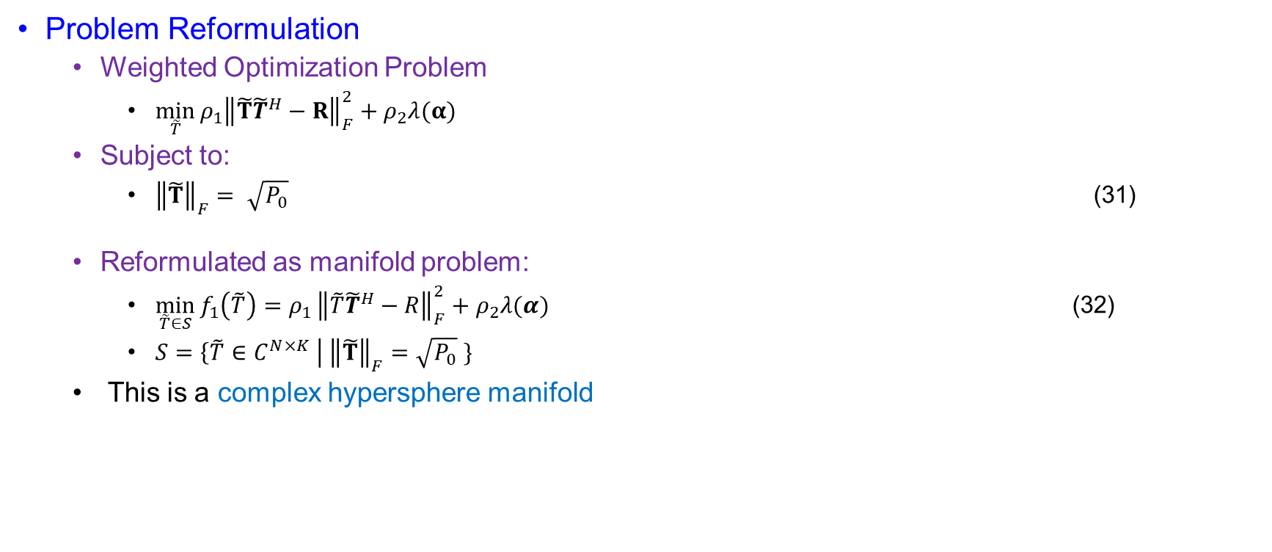
Beamforming Optimization on The Manifold
Problem Reformulation
  Weighted Optimization Problem
    $\min_{\tilde{T}}{ρ_{1}{\left\|\tilde{T}{\tilde{T}}^{H}−R\right\|}_{F}^{2}}+ρ_{2}λ(α)$
  Subject to:
    ${\left\|\tilde{T}\right\|}_{F}= \sqrt{P_{0}}$ (31)
  Reformulated as manifold problem:
    $\min_{\tilde{T}∈S}{f_{1}\left(\tilde{T}\right)=ρ_{1}}{\left\|\tilde{T}{\tilde{T}}^{H}−R\right\|}_{F}^{2}+ρ_{2}λ(α)$ (32)
    $S=\left\{\tilde{T}∈C^{N×K} \right| {\left\|\tilde{T}\right\|}_{F}=\sqrt{P_{0}} \}$
  This is a complex hypersphere manifold

Slide 37
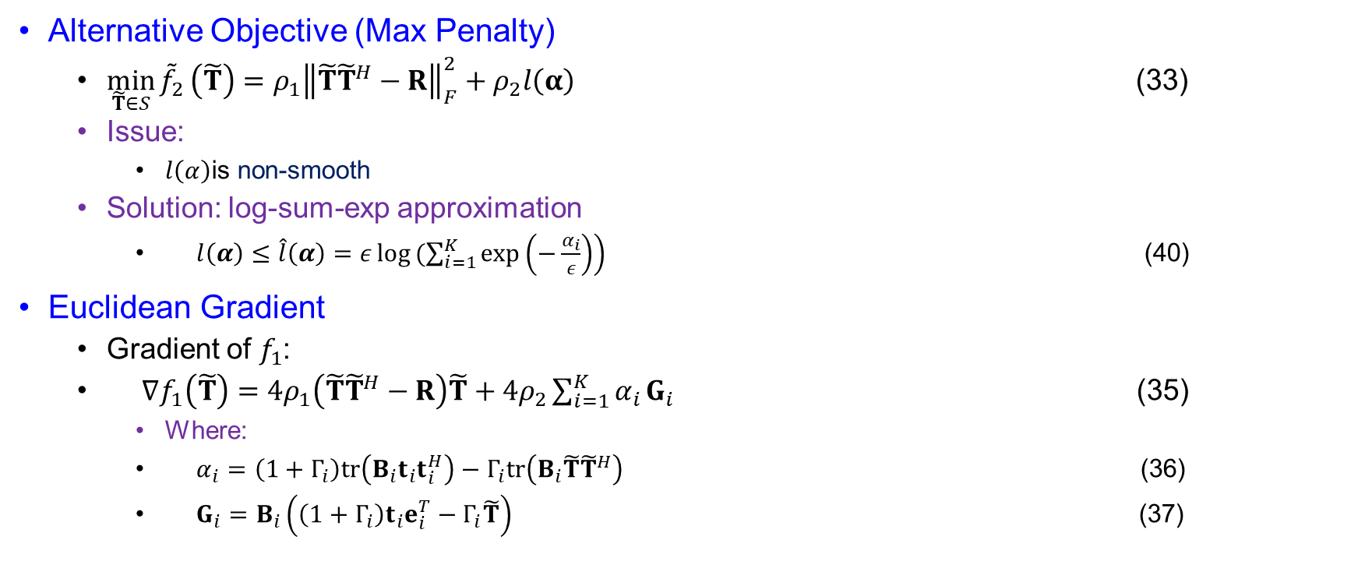
Beamforming Optimization on The Manifold
Alternative Objective (Max Penalty)
  $\min_{\tilde{T}∈S}{{\tilde{f}}_{2}}\left(\tilde{T}\right)=ρ_{1}{\left\|\tilde{T}{\tilde{T}}^{H}−R\right\|}_{F}^{2}+ρ_{2}l\left(α\right)$ (33)
  Issue:
    $l\left(α\right)$is non-smooth
  Solution: log-sum-exp approximation
    $\begin{matrix} & l\left(α\right)≤\hat{l}\left(α\right)=ε\log\left.(\sum_{i=1}^{K}{exp}\left(−\frac{α_{i}}{ε}\right)\right) & & \end{matrix}$ (40)
Euclidean Gradient
  Gradient of $f_{1}$:
  $\begin{matrix} & ∇f_{1}\left(\tilde{T}\right)=4ρ_{1}\left(\tilde{T}{\tilde{T}}^{H}−R\right)\tilde{T}+4ρ_{2}\sum_{i=1}^{K}{α_{i}}G_{i} & & \end{matrix}$ (35)
    Where:
    $\begin{matrix} & α_{i}=\left(1+Γ_{i}\right)tr⁡\left(B_{i}t_{i}t_{i}^{H}\right)−Γ_{i}tr⁡\left(B_{i}\tilde{T}{\tilde{T}}^{H}\right) & & \end{matrix}$ (36)
    $\begin{matrix} & G_{i}=B_{i}\left(\left(1+Γ_{i}\right)t_{i}e_{i}^{T}−Γ_{i}\tilde{T}\right) & & \end{matrix}$ (37)

Slide 38
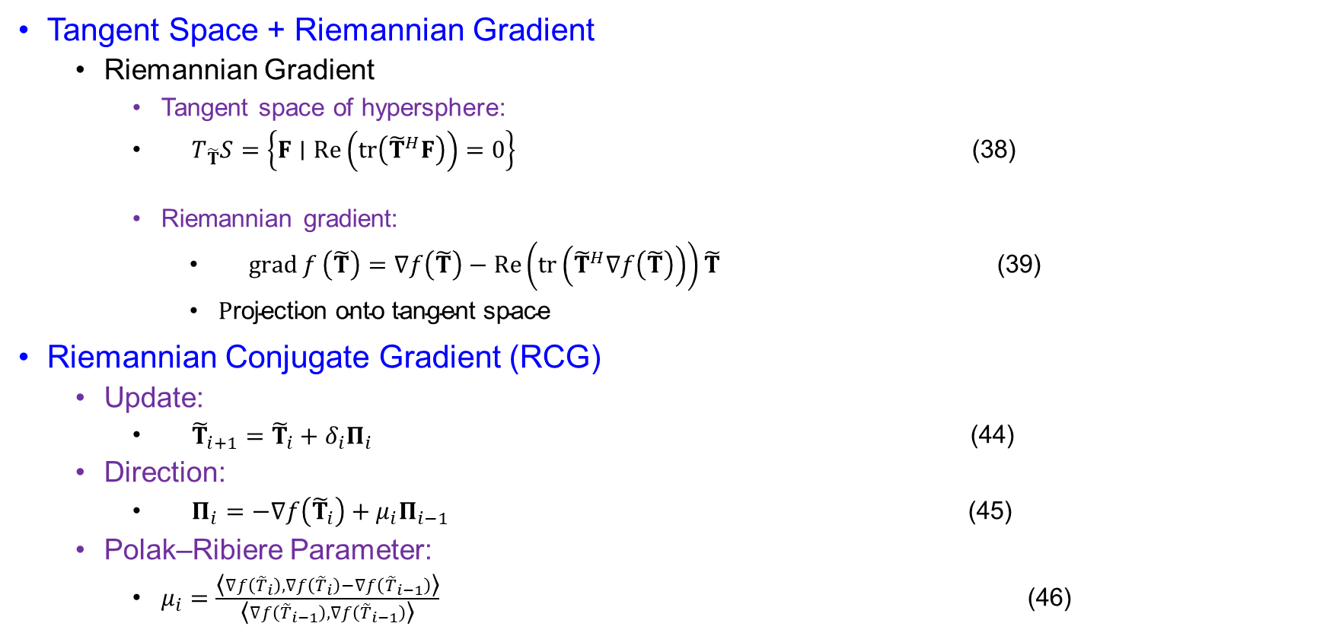
Beamforming Optimization on The Manifold
Tangent Space + Riemannian Gradient
  Riemannian Gradient
    Tangent space of hypersphere:
    $\begin{matrix} & T_{\tilde{T}}S=\left\{F∣\operatorname{Re}\left(tr⁡\left({\tilde{T}}^{H}F\right)\right)=0\right\} & & \end{matrix}$ (38)
    Riemannian gradient:
      $\begin{matrix} & \operatorname{grad}{f}\left(\tilde{T}\right)=∇f\left(\tilde{T}\right)−\operatorname{Re}\left(tr⁡\left({\tilde{T}}^{H}∇f\left(\tilde{T}\right)\right)\right)\tilde{T} & & \end{matrix}$ (39)
      $\text{P}\text{rojection} \text{onto} \text{tangent} \text{space}$
Riemannian Conjugate Gradient (RCG)
  Update:
    $\begin{matrix} & {\tilde{T}}_{i+1}={\tilde{T}}_{i}+δ_{i}Π_{i} & & \end{matrix}$ (44)
  Direction:
    $\begin{matrix} & Π_{i}=−∇f\left({\tilde{T}}_{i}\right)+μ_{i}Π_{i−1} & & \end{matrix}$ (45)
  Polak–Ribiere Parameter:
    $μ_{i}=\frac{\text{⟨}∇f\left({\tilde{T}}_{i}\right),∇f\left({\tilde{T}}_{i}\right)−∇f\left({\tilde{T}}_{i−1}\right)\text{⟩}}{\text{⟨}∇f\left({\tilde{T}}_{i−1}\right), ∇f\left({\tilde{T}}_{i−1}\right)\text{⟩}}\begin{matrix} & & & \end{matrix}$ (46)

Slide 39

Beamforming Optimization on The Manifold
Retraction Step
  After update, project back to manifold:
    $\begin{matrix} & {\tilde{T}}_{i+1}=\sqrt{P_{0}} \frac{{\tilde{T}}_{i}+δ_{i}Π_{i}}{∥{\tilde{T}}_{i}+δ_{i}Π_{i}∥_{F}} & & \end{matrix}$ (48)
  Keeps solution on hypersphere
  Vector Transport
    $T_{{\tilde{T}}_{i−1}}\left(gradf\left({\tilde{T}}_{i−1}\right)\right)=Proj_{{\overline{T}}_{i}}\left(gradf\left({\tilde{T}}_{i−1}\right)\right)$ (49)
  Final direction:
    $\begin{matrix} & Π_{i}=−\operatorname{grad}{f}\left({\tilde{T}}_{i}\right)+μ_{i}𝒯_{{\tilde{T}}_{i−1}}\left(Π_{i−1}\right) & & \end{matrix}$ (51)

Slide 40

Beamforming Optimization on The Manifold
RCG Algorithm (Algorithm 2)
  Initialize ${\tilde{T}}_{0}∈𝒮$
  Set:
    $Π_{0}=−\operatorname{grad}{f}\left({\tilde{T}}_{0}\right)$
  Repeat:
    compute step size (Armijo rule)
    update via retraction
    compute $μ_{i}$
    update direction
  Stop when:
    $∥\operatorname{grad}{f}\left(\tilde{T}\right)∥_{F}≤Δ$

Slide 41
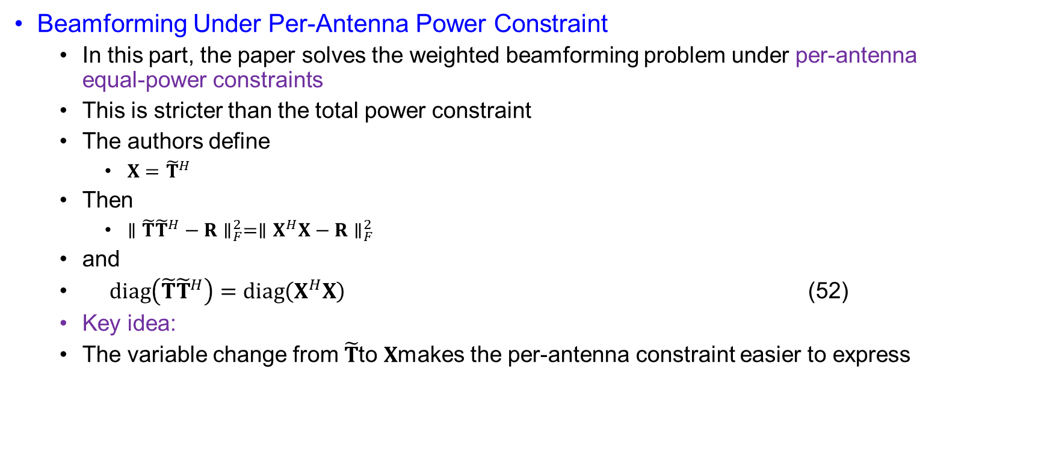
Beamforming Under Per-Antenna Power Constraint
Beamforming Under Per-Antenna Power Constraint
  In this part, the paper solves the weighted beamforming problem under per-antenna equal-power constraints
  This is stricter than the total power constraint
  The authors define
    $X={\tilde{T}}^{H}$
  Then
    $∥\tilde{T}{\tilde{T}}^{H}−R∥_{F}^{2}=∥X^{H}X−R∥_{F}^{2}$
  and
  $\begin{matrix} & diag⁡\left(\tilde{T}{\tilde{T}}^{H}\right)=diag⁡\left(X^{H}X\right) & & \end{matrix}$ (52)
  Key idea:
  The variable change from $\tilde{T}$to $X$makes the per-antenna constraint easier to express

Slide 42
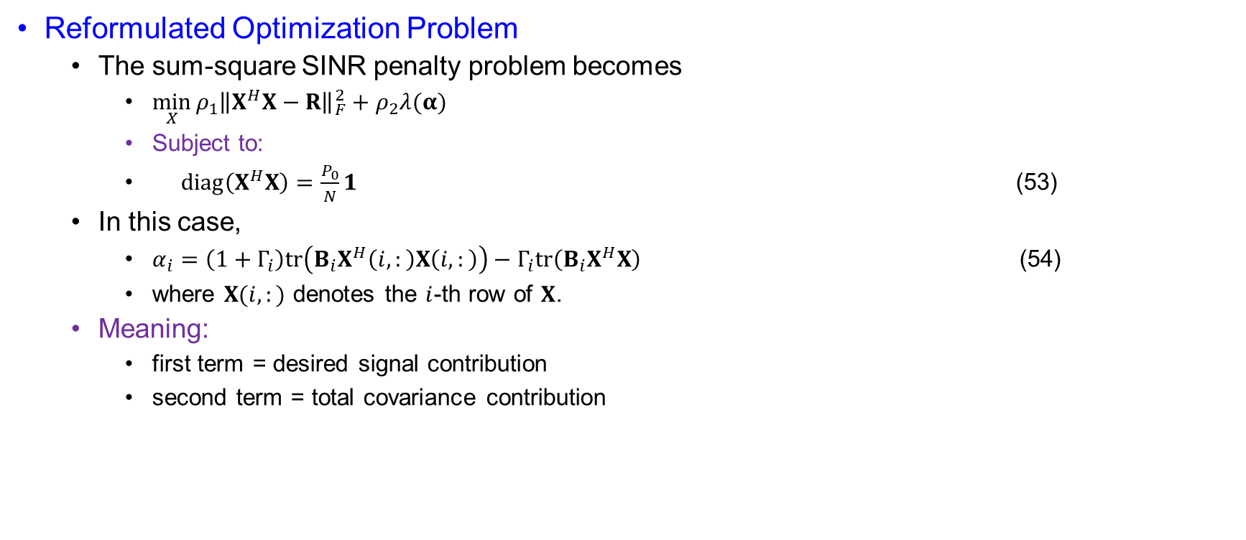
Beamforming Under Per-Antenna Power Constraint
Reformulated Optimization Problem
  The sum-square SINR penalty problem becomes
    $\min_{X}{ρ_{1}{\left\|X^{H}X−R\right\|}_{F}^{2}+ρ_{2}λ(α)}$
    Subject to:
    $\begin{matrix} & diag⁡\left(X^{H}X\right)=\frac{P_{0}}{N}1 & & \end{matrix}$ (53)
  In this case,
    $α_{i}=\left(1+Γ_{i}\right)tr\left(B_{i}X^{H}\left(i,:\right)X\left(i,:\right)\right)−Γ_{i}tr\left(B_{i}X^{H}X\right)$ (54)
    where $X(i,:)$ denotes the $i$-th row of $X$.
  Meaning:
    first term = desired signal contribution
    second term = total covariance contribution

Slide 43
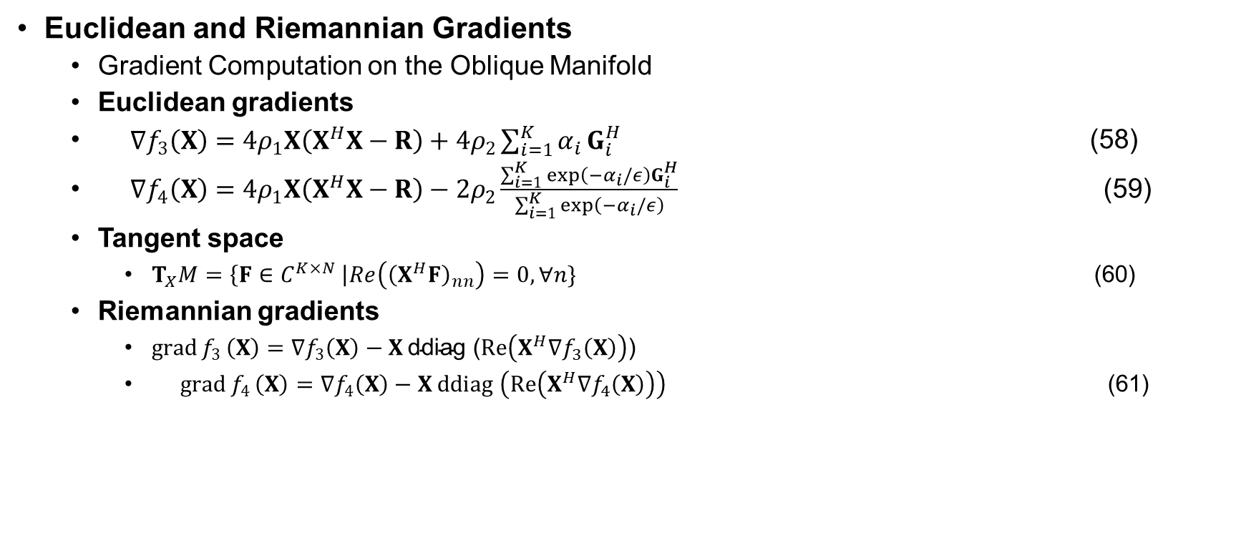
Beamforming Under Per-Antenna Power Constraint
Euclidean and Riemannian Gradients
  Gradient Computation on the Oblique Manifold
  Euclidean gradients
  $\begin{matrix} & ∇f_{3}\left(X\right)=4ρ_{1}X\left(X^{H}X−R\right)+4ρ_{2}\sum_{i=1}^{K}{α_{i}}G_{i}^{H} & & \end{matrix}$ (58)
  $\begin{matrix} & ∇f_{4}\left(X\right)=4ρ_{1}X\left(X^{H}X−R\right)−2ρ_{2}\frac{\sum_{i=1}^{K}{exp}⁡\left(−α_{i}/ε\right)G_{i}^{H}}{\sum_{i=1}^{K}{exp}⁡\left(−α_{i}/ε\right)} & & \end{matrix}$ (59)
  Tangent space
    $T_{X}M=\left\{F∈C^{K×N} \right|Re\left({\left(X^{H}F\right)}_{nn}\right)=0, ∀n\}$ (60)
  Riemannian gradients
    $\operatorname{grad}{f_{3}}\left(X\right)=∇f_{3}\left(X\right)−X \text{ddiag} \text{(}Re⁡\left(X^{H}∇f_{3}\left(X\right)\right)\text{)}$
    $\begin{matrix} & \operatorname{grad}{f_{4}}\left(X\right)=∇f_{4}\left(X\right)−X ddiag \left(\operatorname{Re}\left(X^{H}∇f_{4}\left(X\right)\right)\right) & & \end{matrix}$ (61)

Slide 44
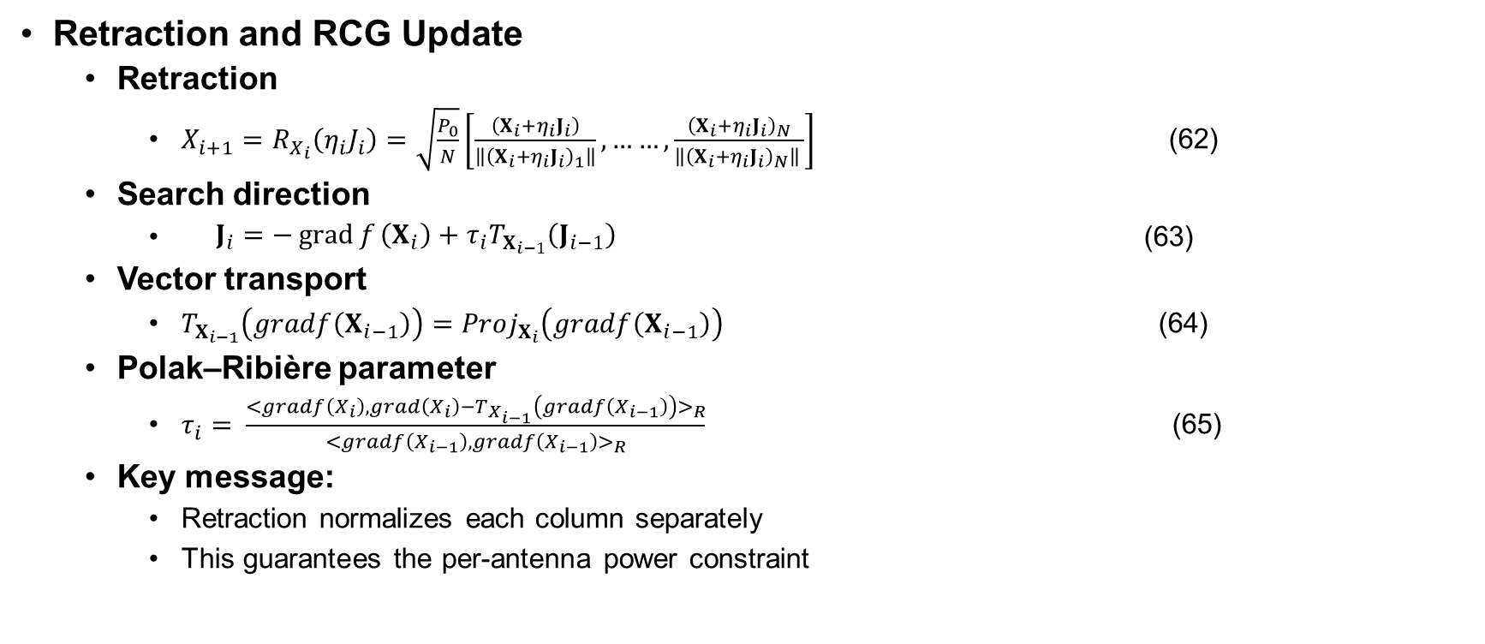
Beamforming Under Per-Antenna Power Constraint
Retraction and RCG Update
  Retraction
    $X_{i+1}=R_{X_{i}}\left(η_{i}J_{i}\right)=\sqrt{\frac{P_{0}}{N}}\left[\frac{\left(X_{i}+η_{i}J_{i}\right)}{\left\|{\left(X_{i}+η_{i}J_{i}\right)}_{1}\right\|},……,\frac{{\left(X_{i}+η_{i}J_{i}\right)}_{N}}{\left\|{\left(X_{i}+η_{i}J_{i}\right)}_{N}\right\| }\right]$ (62)
  Search direction
    $\begin{matrix} & J_{i}=−\operatorname{grad}{f}\left(X_{i}\right)+τ_{i}T_{X_{i−1}}\left(J_{i−1}\right) & & \end{matrix}$ (63)
  Vector transport
    $T_{X_{i−1}}\left(gradf\left(X_{i−1}\right)\right)=Proj_{X_{i}}\left(gradf\left(X_{i−1}\right)\right)$ (64)
  Polak–Ribière parameter
    $τ_{i}= \frac{<gradf\left(X_{i}\right),grad\left(X_{i}\right)−T_{X_{i−1}}\left(gradf\left(X_{i−1}\right)\right)>_{R}}{<gradf\left(X_{i−1}\right),gradf\left(X_{i−1}\right)>_{R}}$ (65)
  Key message:
    Retraction normalizes each column separately
    This guarantees the per-antenna power constraint

Slide 45
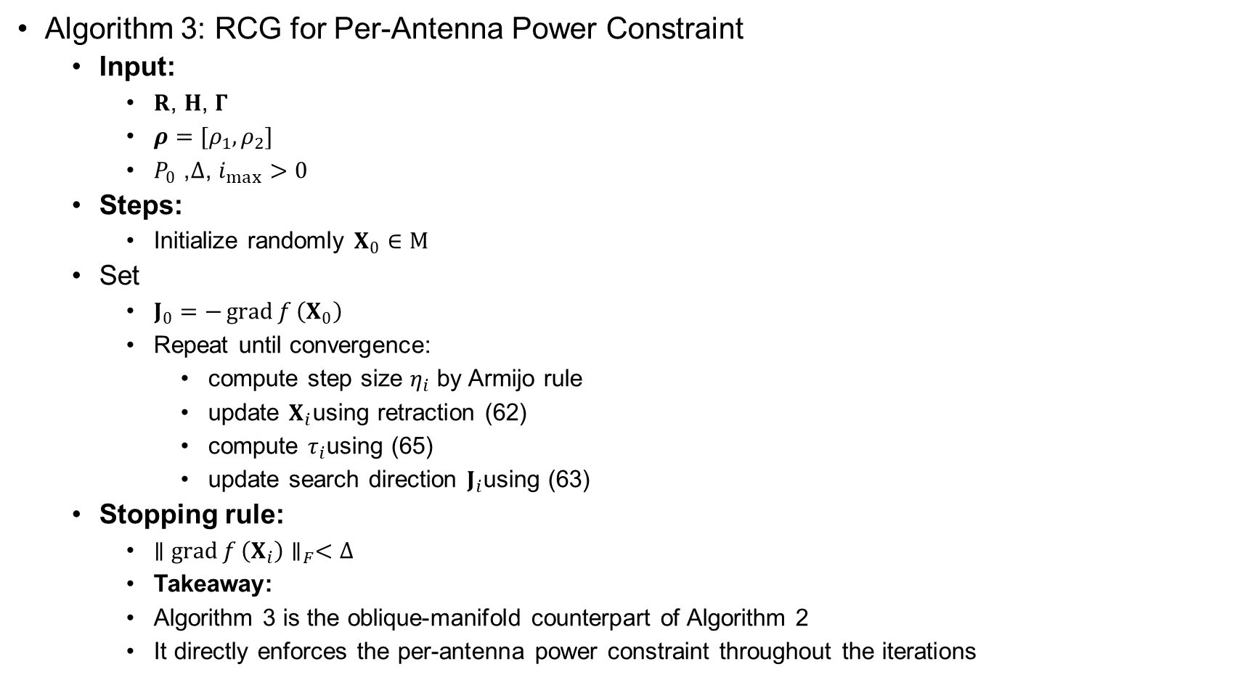
Beamforming Under Per-Antenna Power Constraint
Algorithm 3: RCG for Per-Antenna Power Constraint
  Input:
    $R$, $H$, $Γ$
    $ρ=[ρ_{1},ρ_{2}]$
    $P_{0}$, $Δ$, $i_{max}>0$
  Steps:
    Initialize randomly $X_{0}∈M$
  Set
    $J_{0}=−\operatorname{grad}{f}\left(X_{0}\right)$
    Repeat until convergence:
      compute step size $η_{i}$ by Armijo rule
      update $X_{i}$using retraction (62)
      compute $τ_{i}$using (65)
      update search direction $J_{i}$using (63)
  Stopping rule:
    $∥\operatorname{grad}{f}\left(X_{i}\right)∥_{F}<Δ$
    Takeaway:
    Algorithm 3 is the oblique-manifold counterpart of Algorithm 2
    It directly enforces the per-antenna power constraint throughout the iterations

